Slide 1

Keeping up with the Continuous Release Cycle: Quarter 1, 2020 Updates
Nathan Clouse
Technical Solution Architect
Dynamic Consulting

Slide 2

Nathan Clouse
Technical Solution Architect Dynamic Consulting
Nathan.clouse@dynamicconsulting.com
www.atomicax.com
@NathanClouseAX

Slide 3
TODAY’S AGENDA
What’s new in 10.0.8
Globalization
Simple
Features
What’s new in 10.0.9
Globalization
Simple
Features

Slide 4
New in 10.0.8

Slide 5
Globalization

Slide 6
Globalization
(Poland) Customer information management in Retail POS (also Italy)
(Mexico) Rounding recalculation for tax base amounts in Retail CFDI Global.
(India) Enable changing tax rate type in purchase invoice.
(UAE) Use FTI report layout defined at print management settings under AE country context
(BRA) NF-e XML move as attachment

Slide 7
Globalization (cont.)
(BRA) Use file name from ER configuration for RPS file export

Slide 8
Simple Features

Slide 9
Simple
Allow empty batch attributes values
Make mobile device inventory movement inventory status field editable

Slide 10
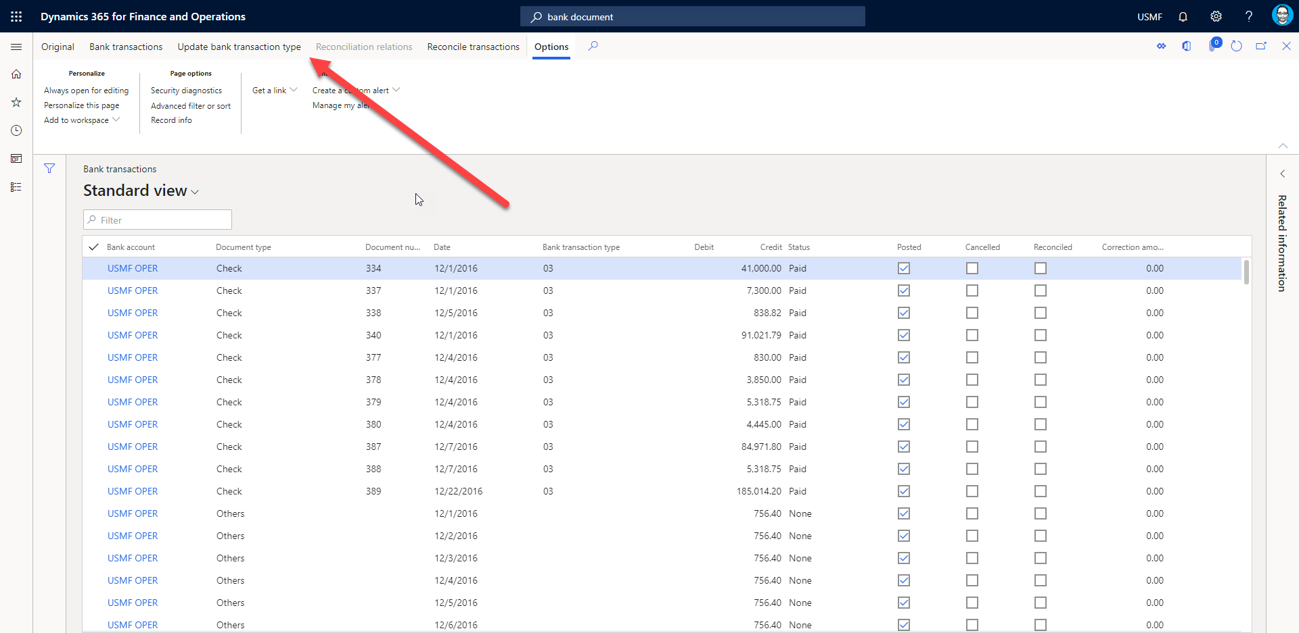
Enable update to bank transaction types for advanced bank reconciliation
Notes:
This feature enables you to set the bank transaction type of a bank document for advanced bank reconciliation.

Slide 11
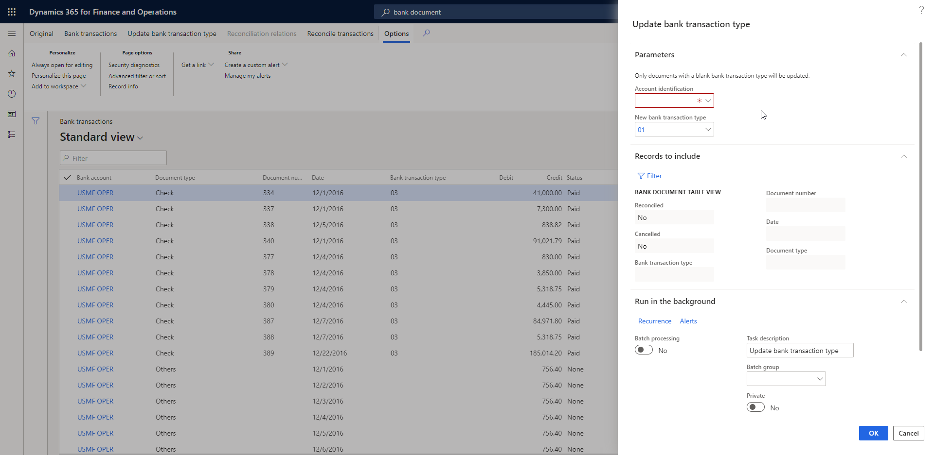
Enable update to bank transaction types for advanced bank reconciliation

Slide 12
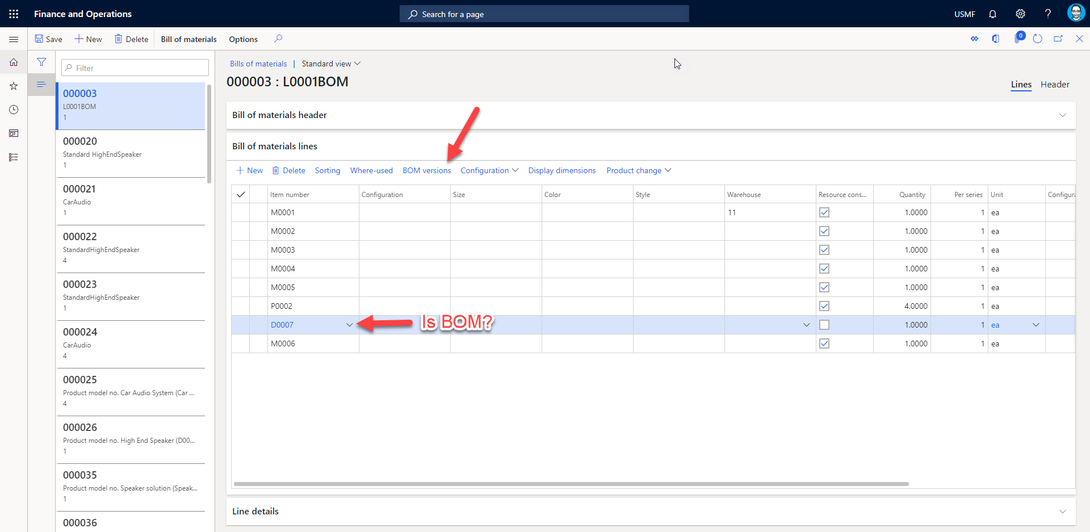
Navigation to BOM version from BOM lines

Slide 13
Purchasing cXML enhancements
This feature includes a set of enhancements to the purchase requisition and purchase order processes when collaborating with suppliers. The external catalog is enhanced with a new trace function to allow the administrators troubleshoot using external catalogs with purchase requisitions. New functionality allows for a purchase order to be sent back to the supplier after being confirmed.
Private Preview

Slide 14
Office-like UI experience for Business document management
This feature implements the Office-like UI experience for end-users who use the Business document management workspace to select a template for editing and to continue editing the selected template.
Public Preview

Slide 15
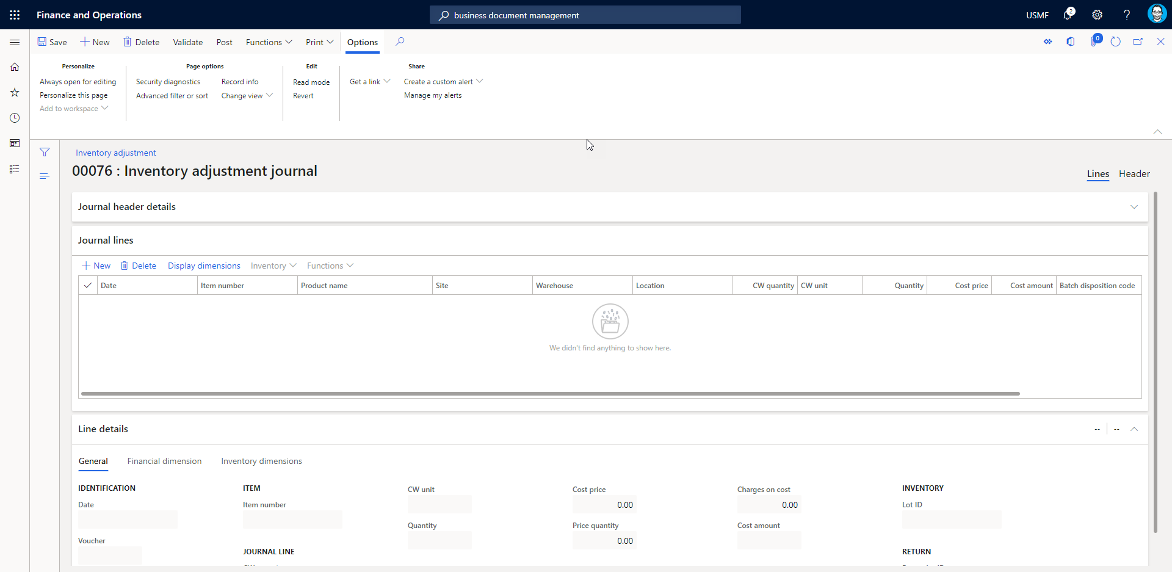
Using unit of measure and unit quantity in inventory journals

Slide 16
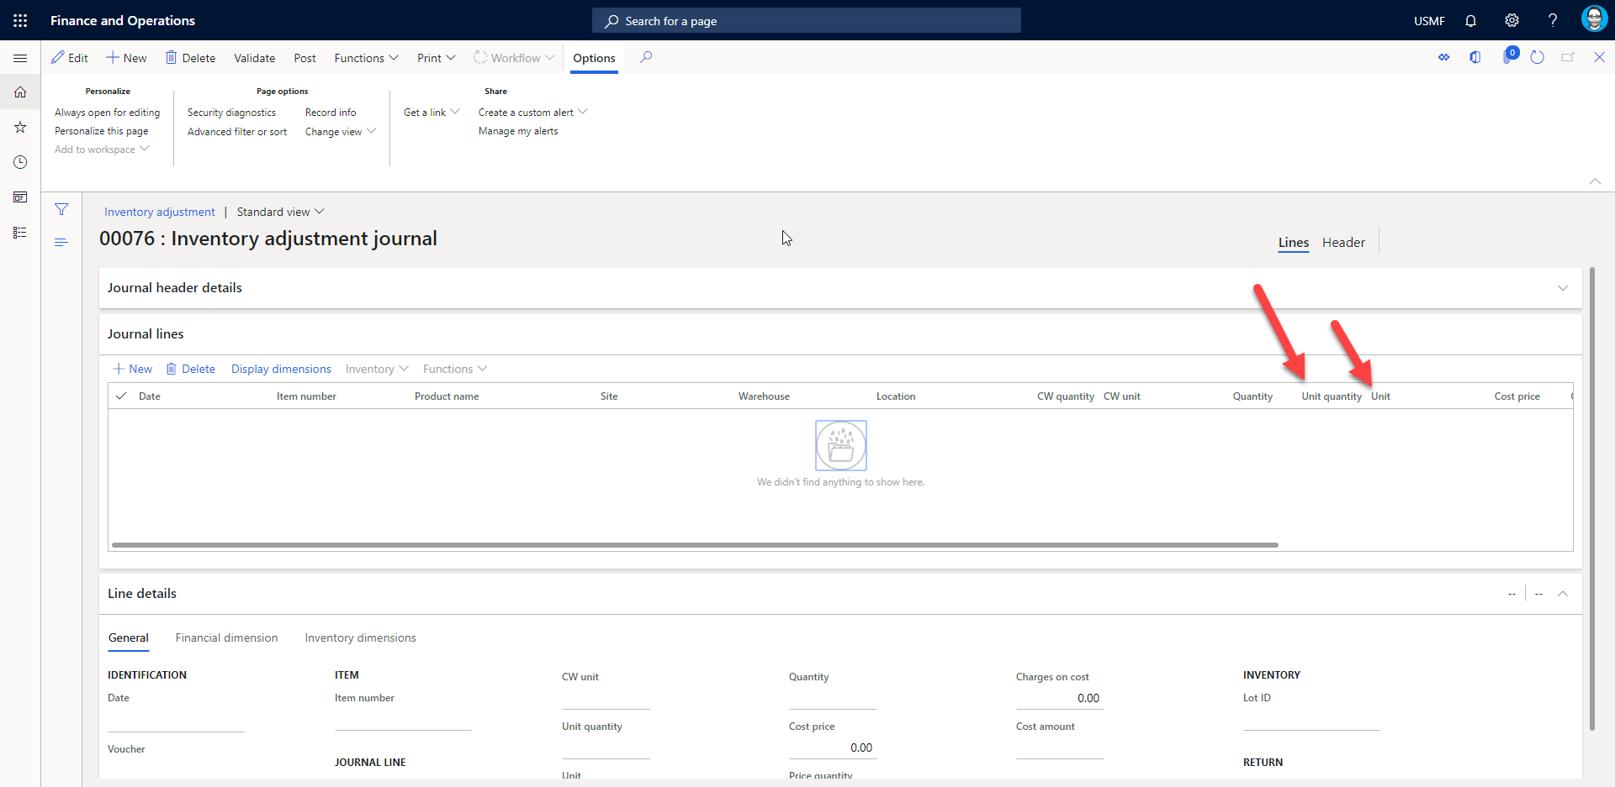
Using unit of measure and unit quantity in inventory journals
Notes:
Enable using unit of measure and unit quantity in inventory journal lines.

Slide 17
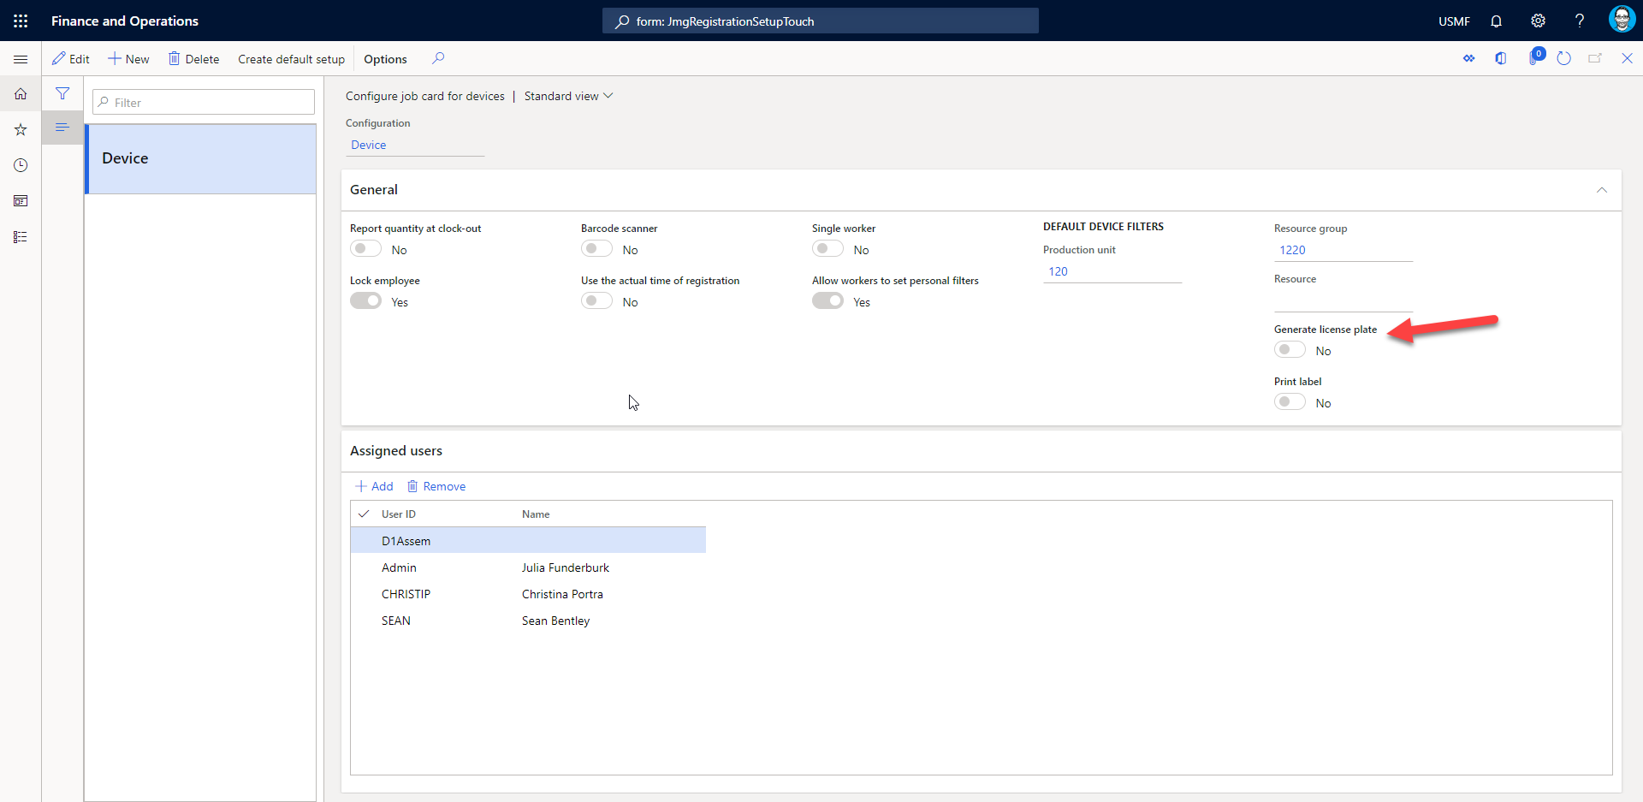
Enable automatic generation of license plate number when reporting as finished in the job card device.
Notes:
Automatically generates LP during feedback and progress reporting in manufacturing execution

Slide 18
Require date range on Posted transactions by journal report
This feature adds From date and To date parameters to the Posted transactions by journal report dialog. The date range is required when generating the report.
Must be from a valid date to a valid date
1/1/2020 – 12/31/2020 is acceptable
(blank) – 12/31/2020 is not acceptable

Slide 19
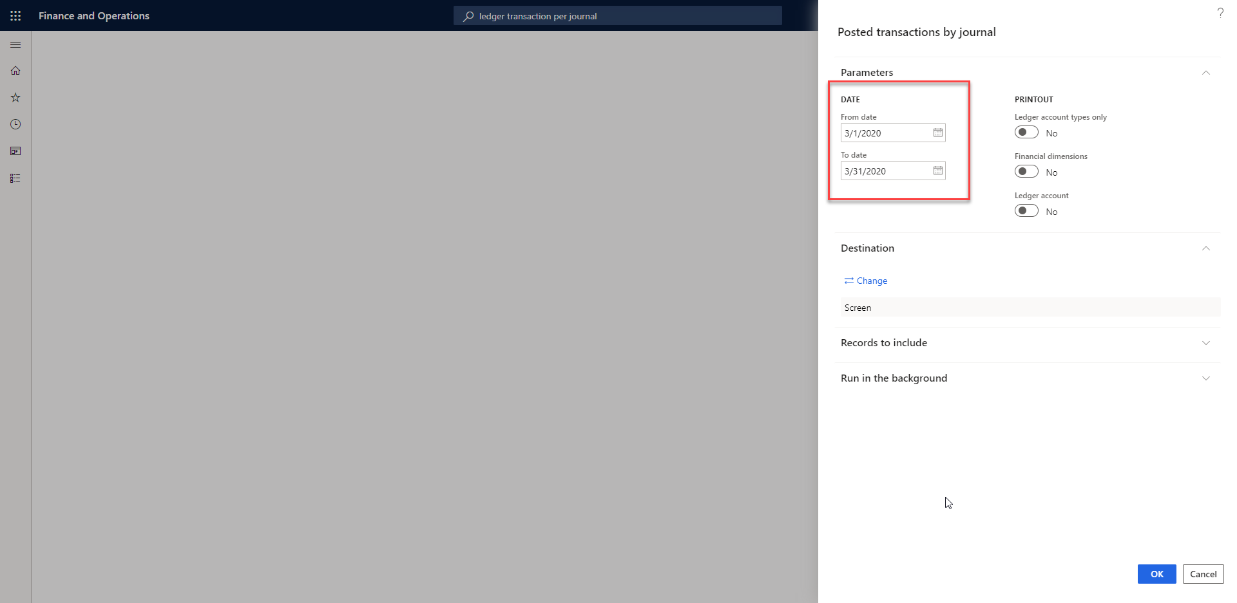
Require date range on Posted transactions by journal report

Slide 20
Enable partial receipt of subcontracted items and fix an issue with the calculation of scrap for BOM lines of type Vendor.
This feature enables partial receipt of subcontracted items. Before, when reporting a partial quantity on a purchase order for a sub contracted service item, the full quantity was updated on the related picking list journal on the production order. Now, the correct partial received quantity is updated. This feature also fixes an issue with an incorrect updated scrap quantity when using BOM lines of type Vendor.

Slide 21
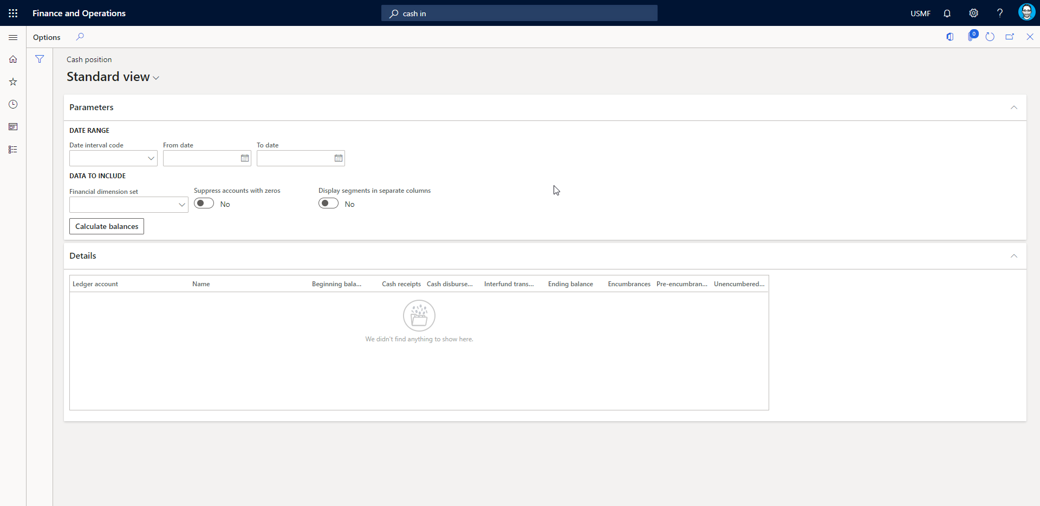
Cash Position Inquiry
Notes:
The Cash position inquiry allows you to determine the corresponding cash positions for financial dimension sets that contain self-balancing dimensions. The inquiry shows the beginning cash balance, and the effect of the addition of cash receipts, the subtraction of cash disbursements, and the subtraction of interfund transfers to arrive at an ending balance. Then, from the ending balance, general budget reservations, encumbrances, or pre-encumbrances are subtracted to arrive at an unencumbered balance. This inquiry is unique in that it allows users to customize the terminology for column names and for the main accounts that are used to derive amounts for the columns. On the Cash position parameters page, the columns that appear in the inquiry are numbered starting with the left-most data column as column one.

Slide 22
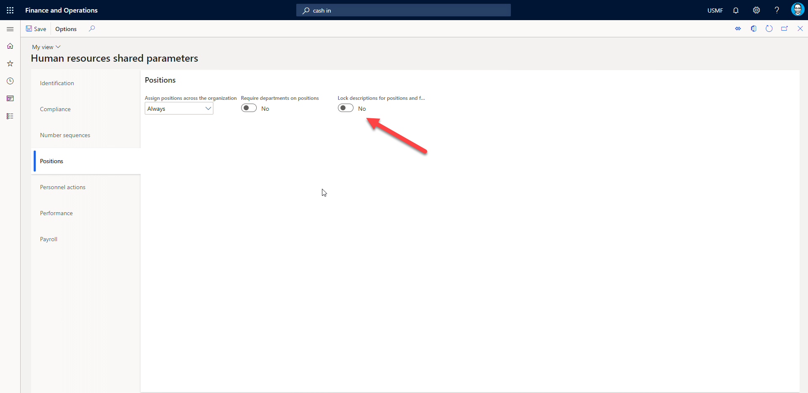
Set job description on the Position and Forecast position pages be read-only

Slide 23
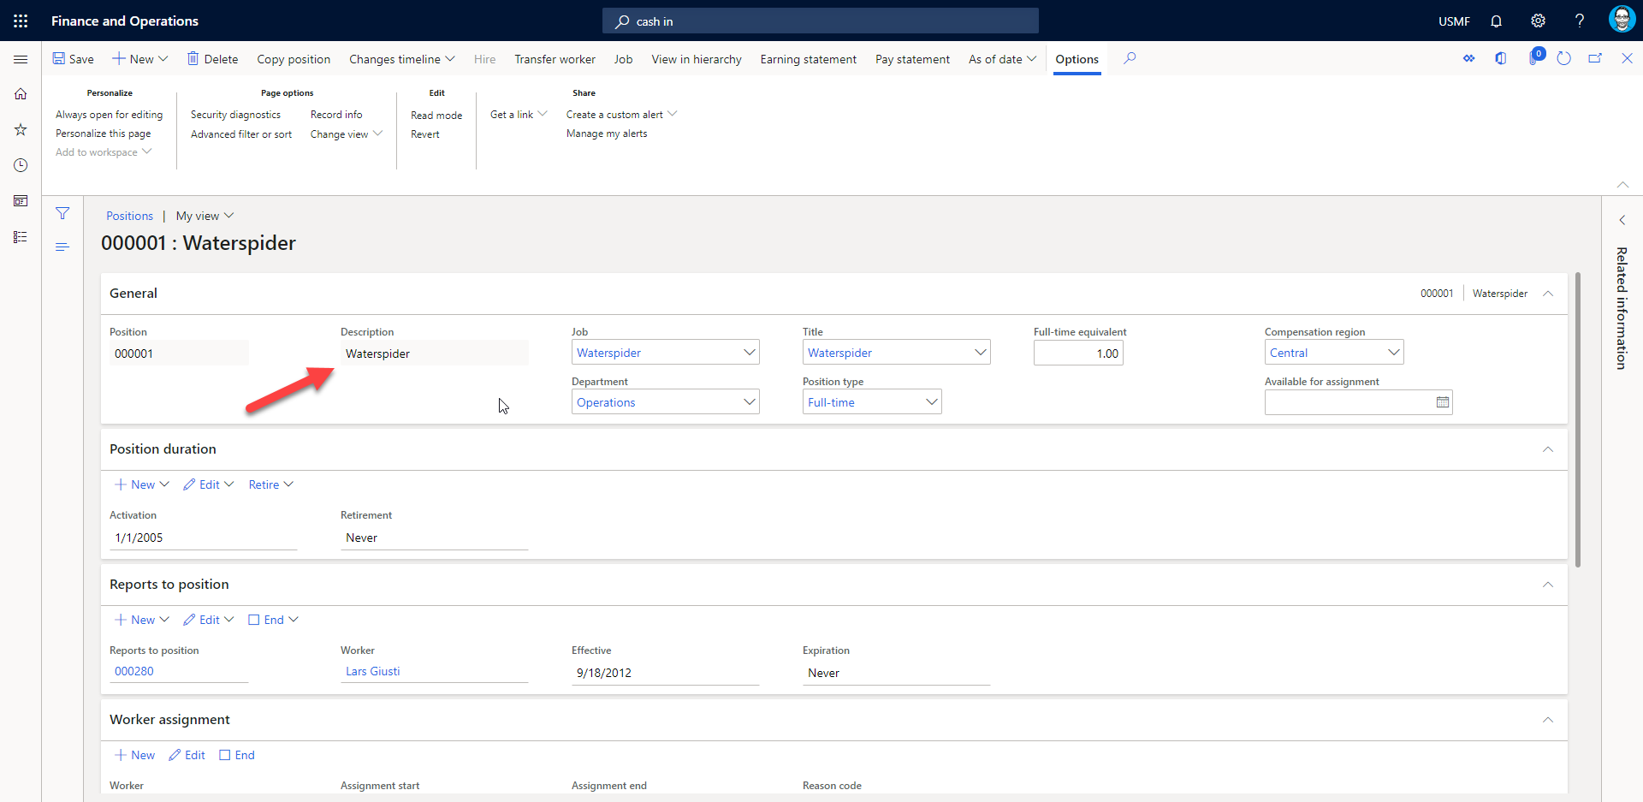
Set job description on the Position and Forecast position pages be read-only
Notes:
Public Sector

Slide 24
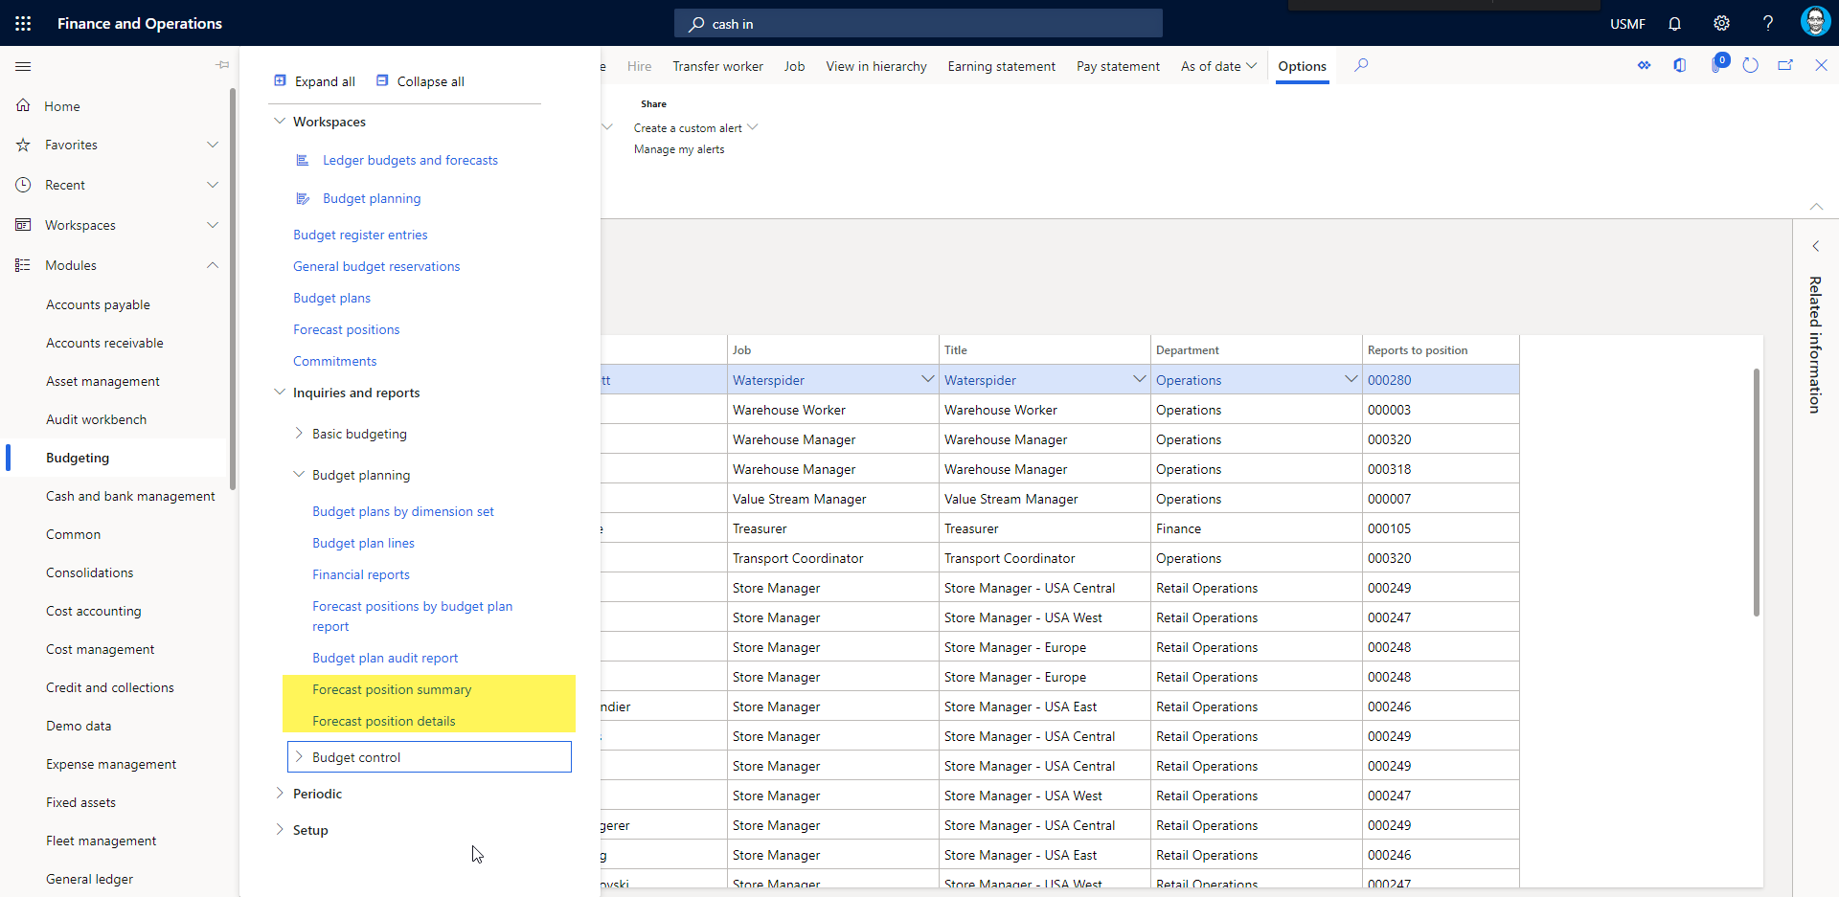
Forecast position detail report
Notes:
Public Sector
this feature enables a Forecast position detail report that contains most of the information displayed on the Forecast position page.

Slide 25
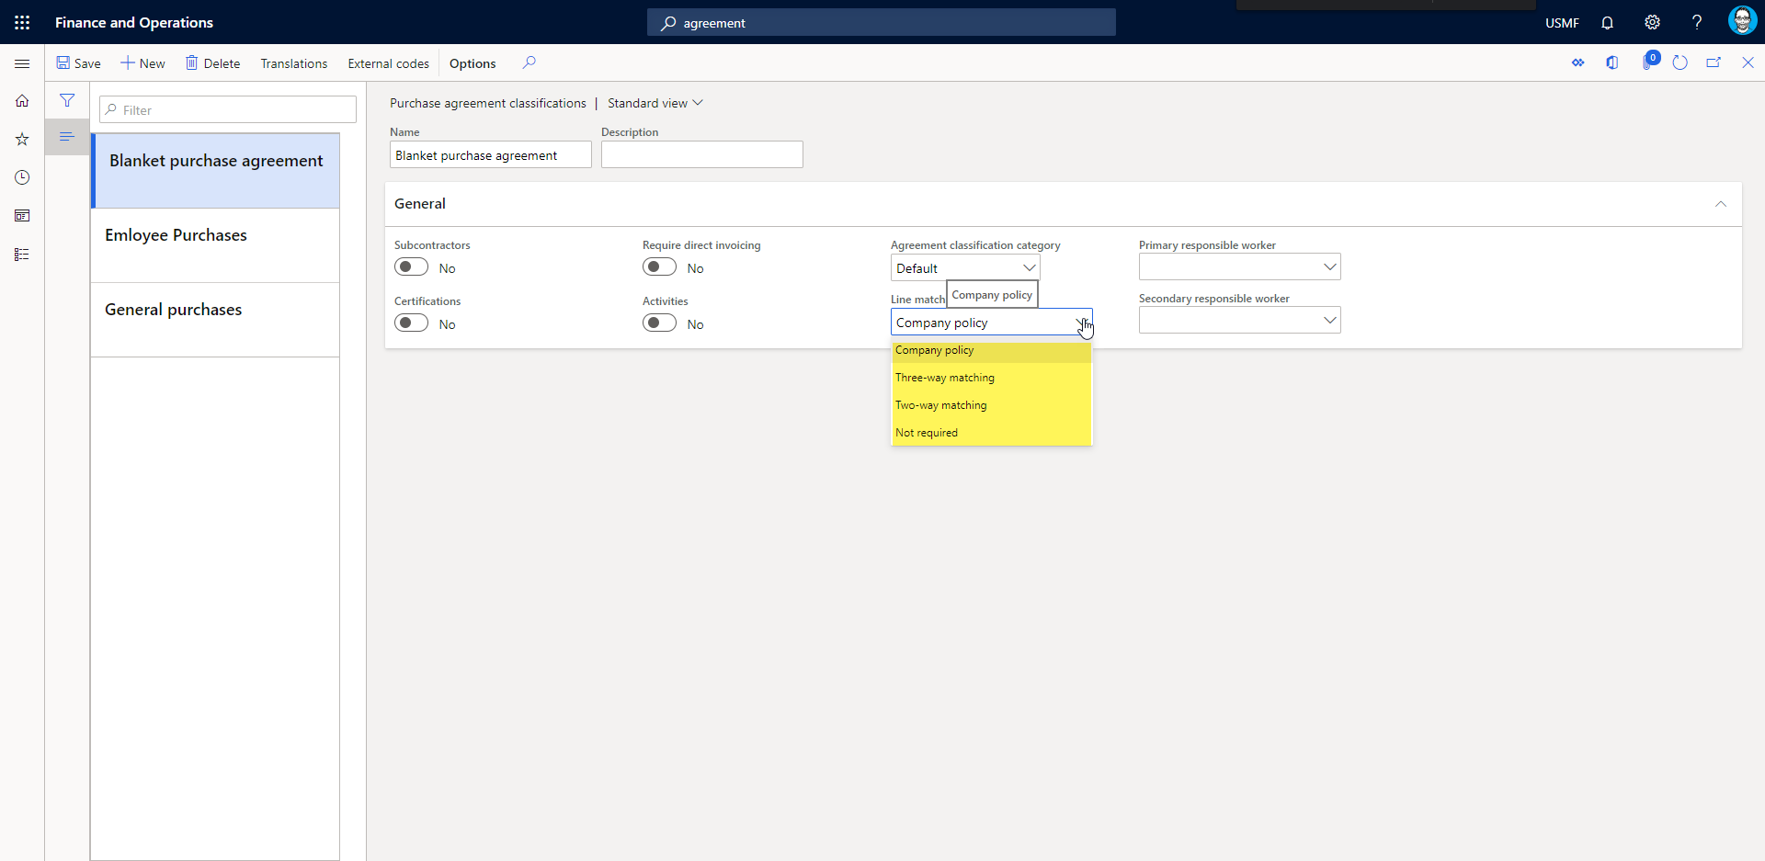
Purchase agreement matching policy
Notes:
Public Sector
Copies onto purchase agreement headers, purchase agreements, Purchase order lines and is also data entity aware

Slide 26
Subledger transfer to General Ledger performance optimization
Enables asynchronous batch for transfer from subledger to GL.
Re-introduction of similar functionality from AX 2012
Uses “reliable asynchronous” transfer from enhancements to batch system introduced in 10.0.6

Slide 27
Auto-match and create expense from receipt
Allows for receipt upload and scan with OCR service
Adds receipts, scans, matches, creates attachment, fills in details
Adds new parameter in Expense Management

Slide 28
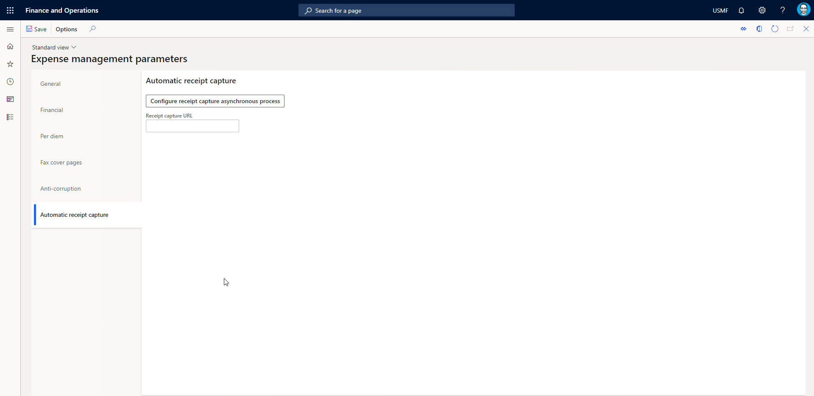
Auto-match and create expense from receipt

Slide 29
Vendor Invoice Workflow Enhancements
Prohibit submission to workflow when the invoice number already exists on a posted invoice, and your system is not set up to accept duplicate invoice numbers.
Notes:
Prohibit submission to workflow when the invoice number already exists on a posted invoice, and your system is not set up to accept duplicate invoice numbers.
This feature lets you prevent a vendor invoice from being submitted to the workflow process when it contains the same invoice number as another posted invoice. Instead, a message alerts the person who submitted the invoice that an invoice with a duplicate number was found and lets them correct it before submitting it to workflow. This alert will be displayed when the Accounts payable parameter labeled “Check the invoice number used” is set to “Reject duplicate.” Finding and resolving issues before invoices are submitted to workflow helps prevent errors that might stop posting and require resubmitting them to workflow later, saving submitters and approvers time in the long run.

Slide 30
Parent license plates cannot be target license plates.
If enabled, parent license plates can be picked in full
Only available for work transactions types of
Raw Material Picking
Sales Orders
Inventory Movement
Transfer Issue
Public Preview

Slide 31
Deferred put - container
If put is before current line…
Closes work’s container
Create batch job to put to location asynchronously
Marks work as complete
Public Preview

Slide 32
New in 10.0.9

Slide 33
Globalization

Slide 34
Globalization
(Switzerland) QR-bills
(CHN) Allow multiple tax codes in VAT customer invoice lines for Chinese Golden tax integration.
Mexico localization Enable allocation terms in Subledger
Polish localization Enable allocation terms in Subledger
(CHN) Configurable payment ID
(MEX) Display referenced documents on the Accounts Receivable Electronic Invoices page list.

Slide 35
Globalization
(IND) Enable to update same GST transaction Id for both shipment and Receiving location.
(BRA) Fix for calculation of sales ICMS-ST withheld on previous operation and without credit

Slide 36
Simple
Improve performance when copying charges to vendor invoice lines
(Preview) Full page apps
Ability to update bank balances when posting an Advanced ledger entry
Associate purchase order inventory transactions with load
Attachments button on the Pending invoices journal form
Budget planning query optimization for performance
Notes:
Ability to update bank balances when posting an Advanced ledger entry - Public Sector - This feature lets you update bank balances when posting an Advanced ledger entry for transactions that affect banking main accounts.
Associate purchase order inventory transactions with load - This feature records inbound load IDs for purchase order inventory transactions as warehouse workers register inbound quantities using a mobile device.
Attachments button on the Pending invoices journal form - This feature enables a header attachments button on Pending invoices page to let users attach or view attachments to invoices
Budget planning query optimization for performance
-

Slide 37
Simple
Convert Electronic Reporting outbound documents from Microsoft Office formats to PDF
Copy tax registration number as default tax exempt number (when creating vendor)
Defaulting of customer business address in the tax information of a sales transaction and Company address in direct delivery Purchase order.
Deferred put processing – enable for audit template feature with trigger event set to Prior
Notes:
Copy tax registration number as default tax exempt number (when creating vendor) - This feature controls the behavior of copying tax registration number as default tax exempt number. If it’s turned on, tax registration number will not be copied as default tax exempt number; If it’s turned off, tax registration number will be copied as default tax exempt number.
Defaulting of customer business address in the tax information of a sales transaction and Company address in direct delivery Purchase order. - This feature will default customer business address in the tax information tab of a sales transaction and company address in the tax information tab of a direct delivery purchase order.
Deferred put processing – enable for audit template feature with trigger event set to Prior - This feature extends the deferred put processing functionality for the audit template with trigger event set to Prior. The trigger event completion and status change are not included.

Slide 38
Simple
Document Routing Agent as Electronic Reporting destination for outbound documents
ECB import on the current or previous date
Enable batch processing for bank payment advice reports
Enable channel return policies
Enable defaulting of fiscal data from invoice account
Enable rounding rules for withholding tax
Enable usage of EPPlus library in Electronic reporting framework
Notes:
ECB import on the current or previous date - This feature introduces a check box on the dialog for importing currency exchange rates for the European Central Bank provider. The user can select either to import the currency exchange rate published on the current date or the rate on the previous date.
Enable batch processing for bank payment advice reports - This feature lets you use batch processing for both the customer and vendor bank payment advice reports. To use this feature you must use BankPaymAdviceVendV2 and BankPaymAdviceCustV2 bank payment advice and set them up as the customer and vendor report formats in print management.
Enable defaulting of fiscal data from invoice account - This feature allows configuring rules for defaulting of fiscal data settings (Tax exempt number and Sales tax group) on sales orders, free text invoices, and purchase orders based on the information from the invoice account or the customer/vendor account.
Enable rounding rules for withholding tax - When this feature is enabled, the withholding tax amount will be rounded respecting the setup: Normal, Downward, Rounding-up, provided transaction currency and tax currency are the same.
Enable usage of EPPlus library instead of Open XML SDK in Electronic reporting framework to manage templates of business documents and use them for generation of outbound documents.

Slide 39
Simple
Evaluate work header breaks before work header maximums during work creation
Filter active positions
Inventory journal approve workflow
Let invoices be submitted to workflow with incomplete or incorrect accounting distributions
Purchase order quantity left to load calculation using registered quantities
Notes:
When this feature is enabled, the work header breaks will be evaluated before the work header maximums.
For movement, inventory adjustment, transfer, BOM, ownership, counting and tag counting
When enabled, the calculation of Quantity left to load for a purchase order line is replaced with a view that shows the registered quantity marked with a load.

Slide 40
Simple
List view of expense reports created by delegating workers.
Prohibit submission to workflow when the invoice total and registered invoice total are not equal.
New expense expression builder to address issues with the inter-company expenses scenarios that use projects.
Purchase order delivery date (Public Sector)
Notes:
Public Sector – This feature enables the ability to calculate delivery date.

Slide 41
Simple
Recommended fields
Retail statements - Trickle feed
Statement of treasurer's accountability report
Sales tax conversion
Notes:
Users often need to add fields to a grid or page; however, with the large number of available fields, this can be difficult. Instead of having to search through a large list, this feature enables the system to surface a set of recommended fields based on what other users most often add in similar scenarios.
Public Sector - The feature enables the Statement of treasurer’s accountability report. While similar to a trial balance report, the new report presents information that’s used as often as daily by public sector treasurers. The report can help identify discrepancies, unexpected balances, possible adjustments needed, and other general audit functions, thereby providing transparency and helping limit data entry mistakes.
This feature enables dual currency support for tax domain. After enabling this feature, user could specify the routing of sales tax amount conversion under different currencies.

Slide 42
(Preview) Grouping in grids
Allows you to group on columns in new grid control
Requires new grid control
Lots of known issues with new grid control
Public Preview

Slide 43
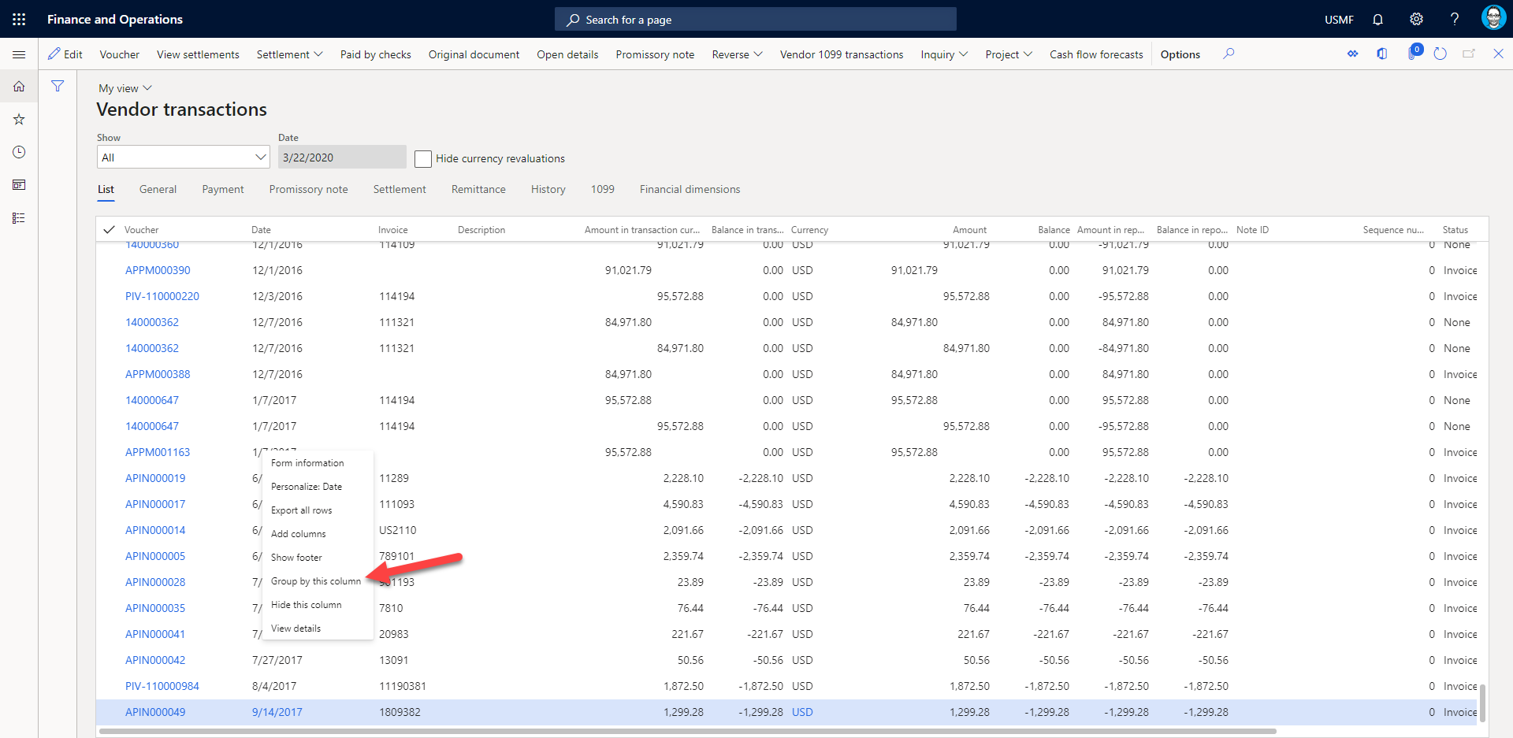
(Preview) Grouping in grids

Slide 44
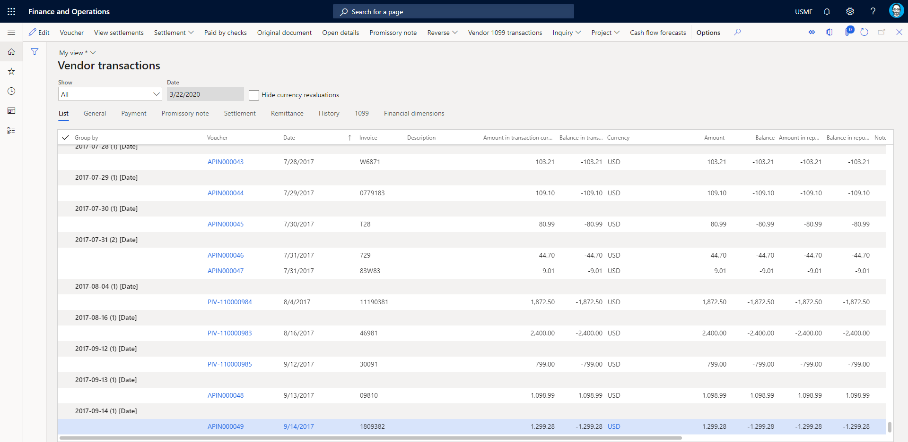
(Preview) Grouping in grids

Slide 45
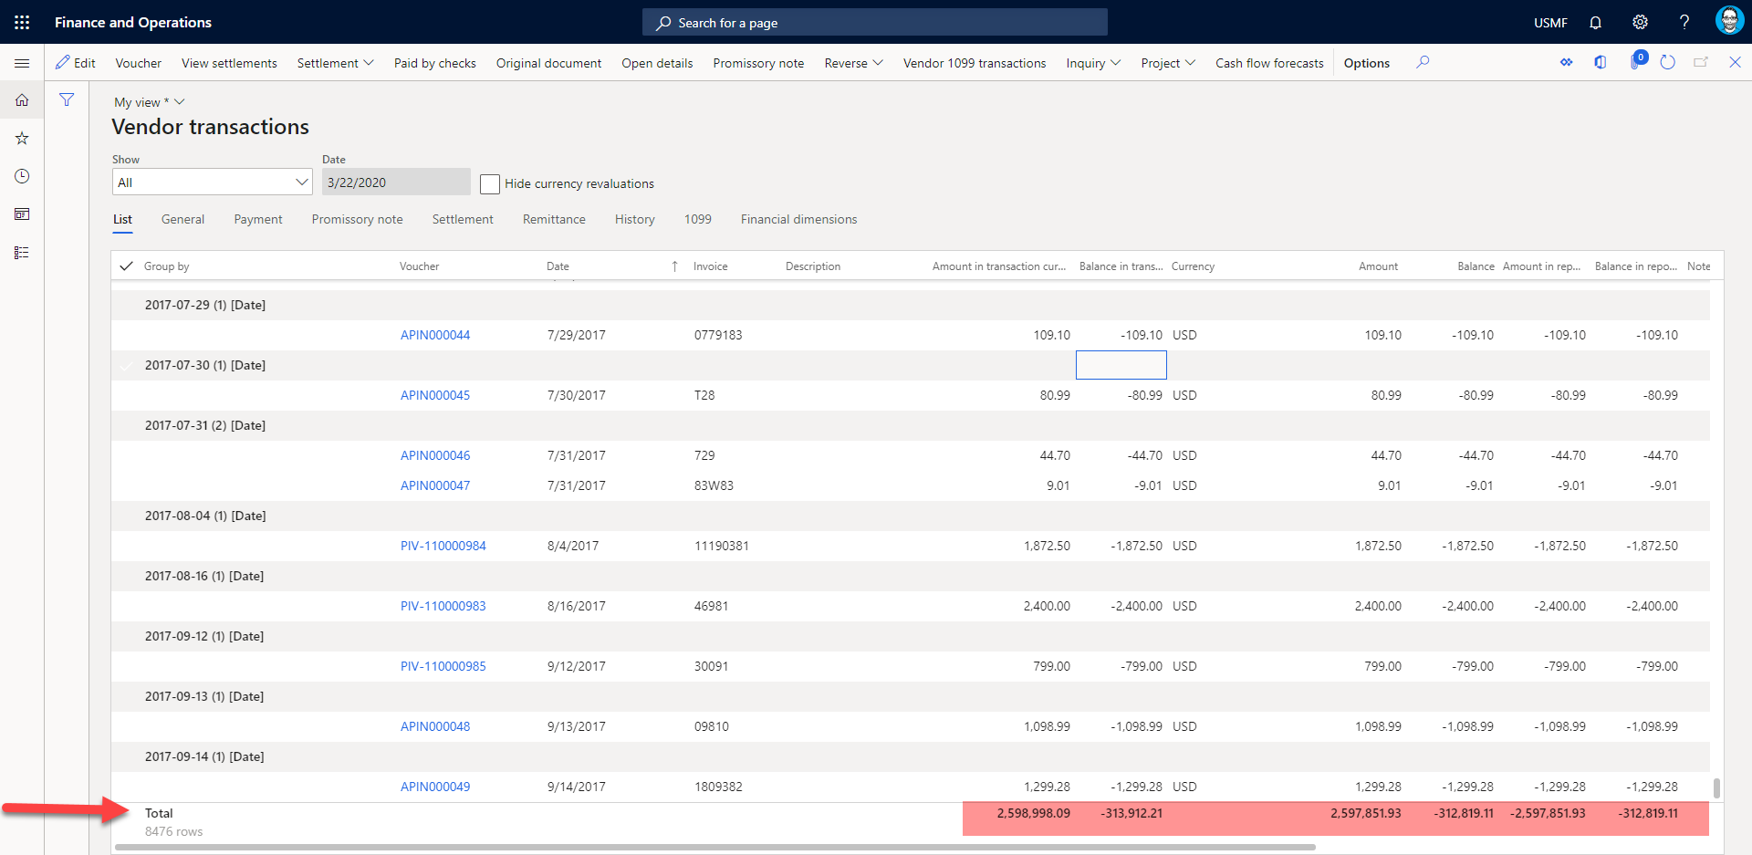
(Preview) Grouping in grids

Slide 46
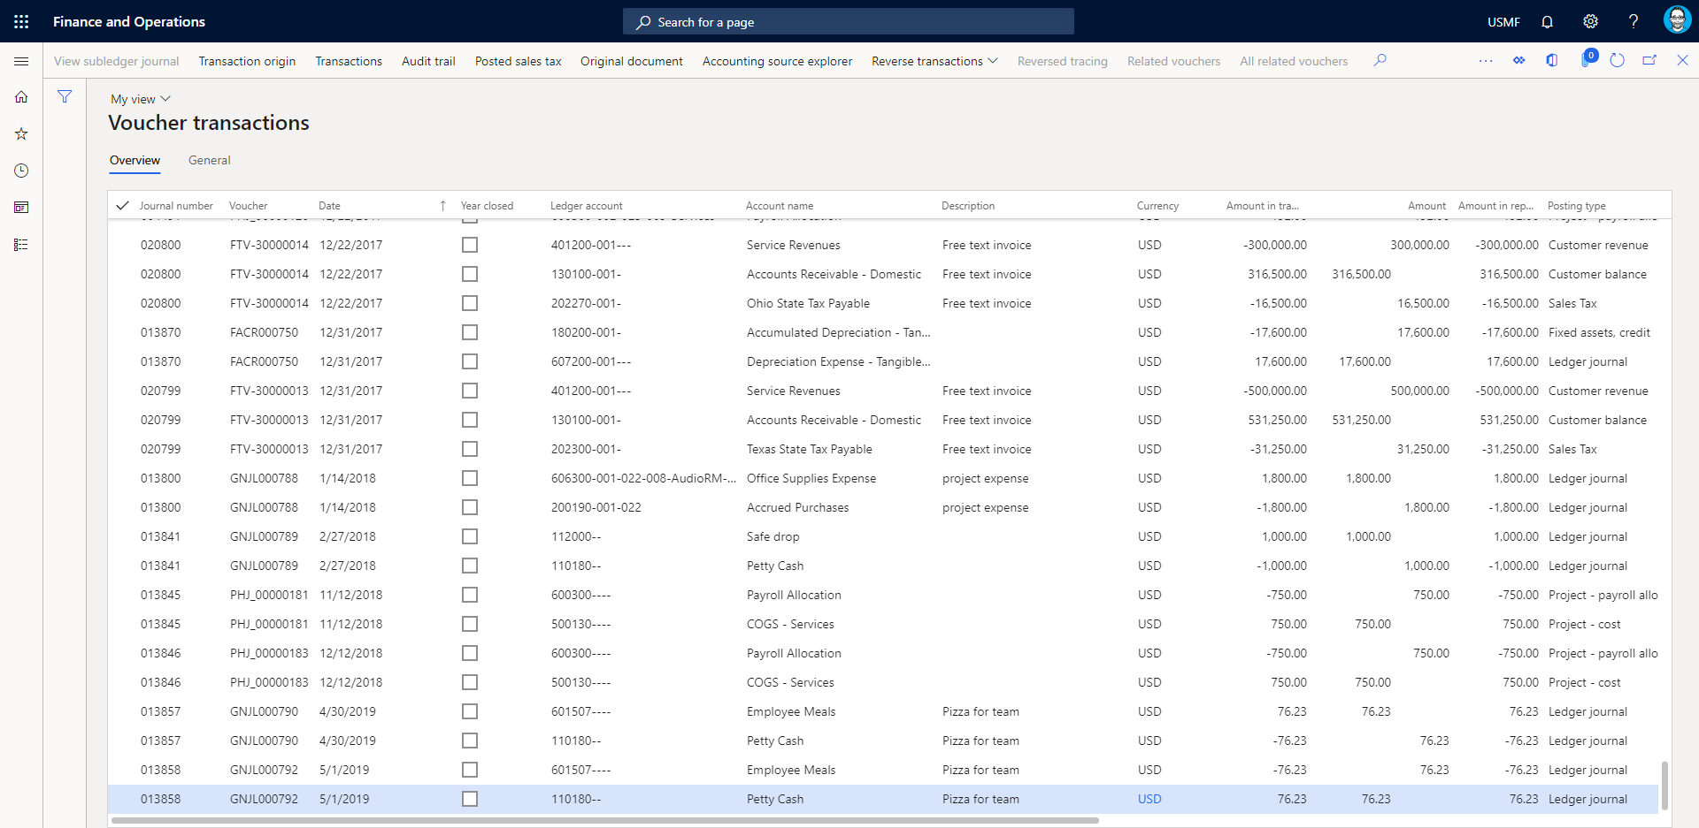
Add Vendor ID, Vendor name, Customer ID, and Customer name to the Voucher transaction list page.

Slide 47
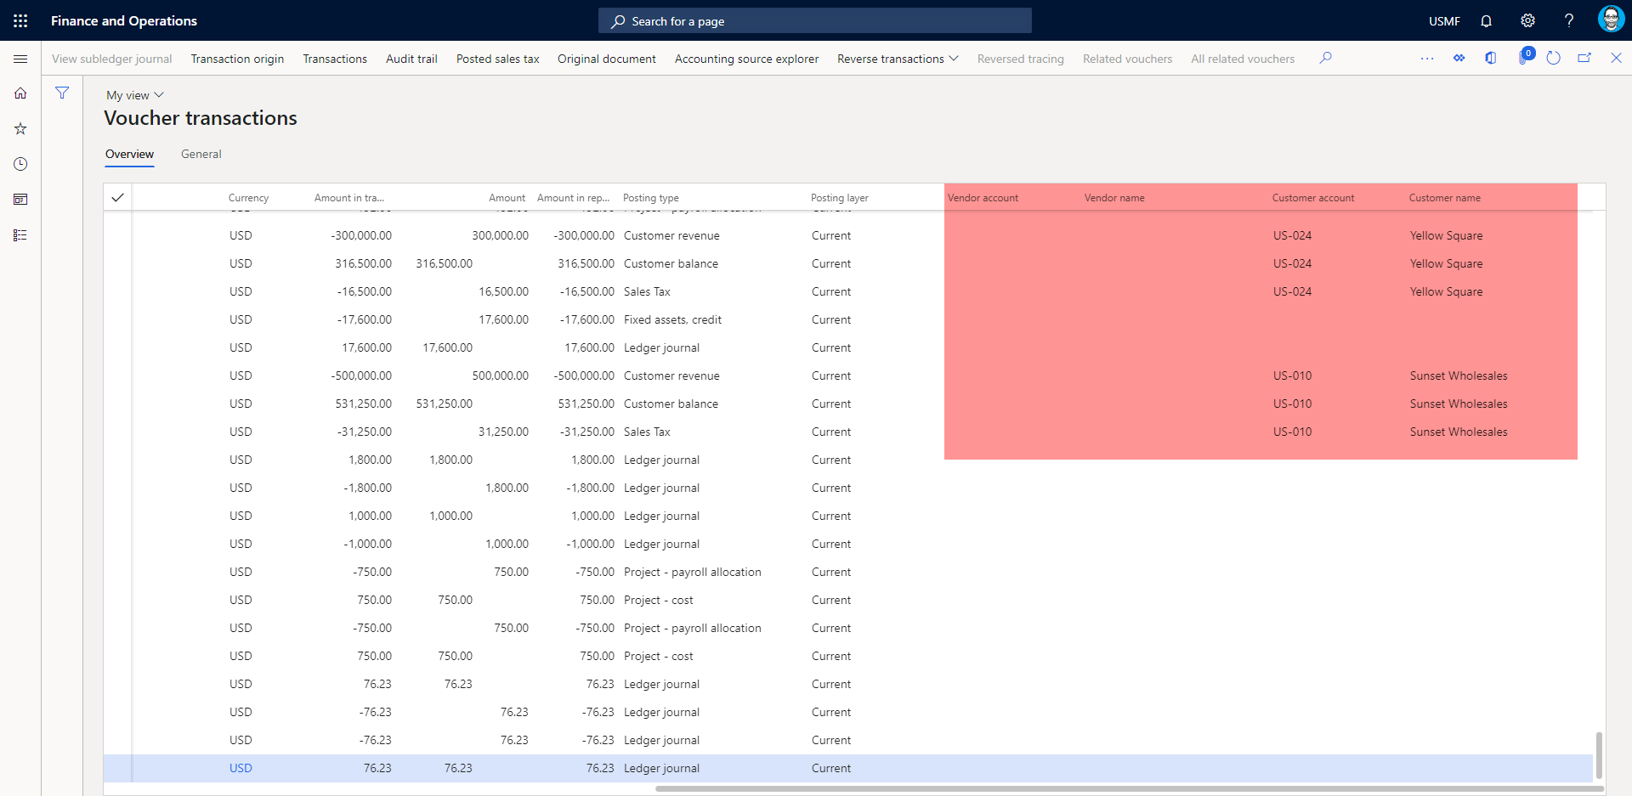
Add Vendor ID, Vendor name, Customer ID, and Customer name to the Voucher transaction list page.

Slide 48
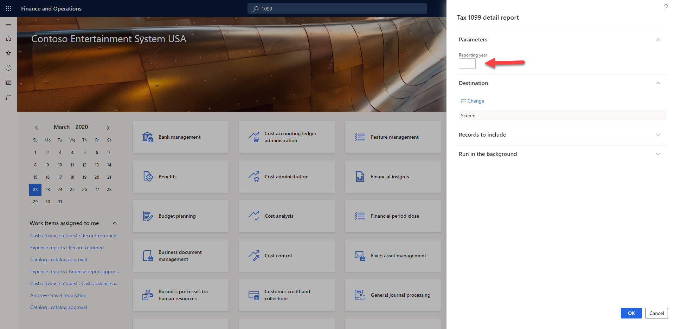
Allow filtering the Tax 1099 detail report by reporting year

Slide 49
Catch weight product processing with warehouse management
https://docs.microsoft.com/en-us/business-applications-release-notes/october18/dynamics365-finance-operations/catch-weight
Lots of new functionality, could be an hour call all by itself
Major improvements to CW
Integrates CW without WHS
Public Preview

Slide 50
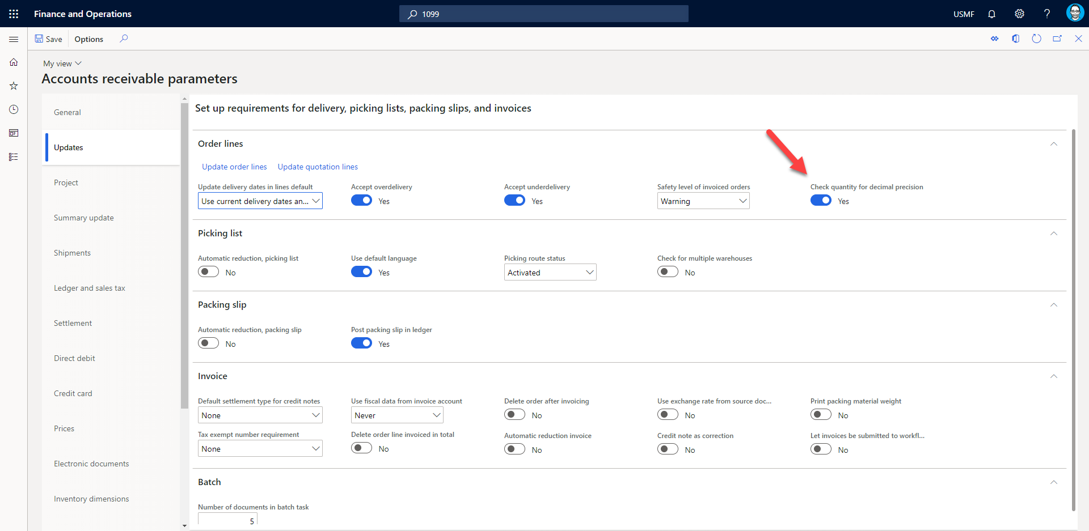
Check unit precision for not-stocked items
Notes:
Add warning if quantity rounded to 2 decimals is different than the value supplied

Slide 51
Cluster Putaway Feature
Putaway clusters are a way to pick multiple license plates at once and take them for a putaway to different locations. It is very useful for e.g. retail industry where many license plates are not full pallets of inventory.
Removes limitations of “Locate By” – includes ASN and Mixed LP
Public Preview

Slide 52
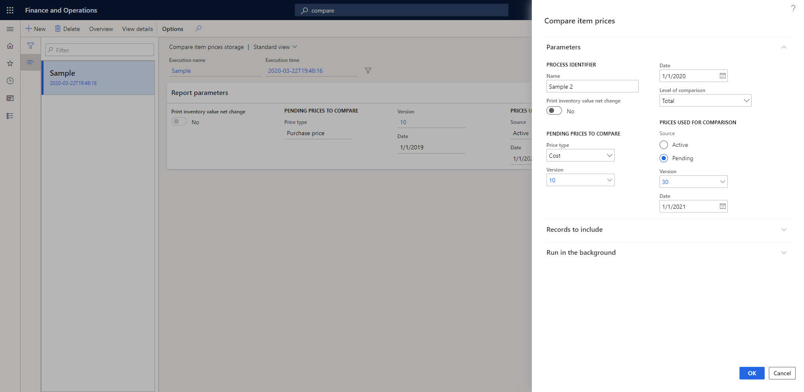
Compare item prices storage
Notes:
This feature provides a new way of executing the Compare item price report and is helpful in cases where the output contains a large number of lines. With the Compare item price storage feature enabled, you can filter the results and drill through to see details by cost group type or cost group, or export the results to an external system.
Released

Slide 53
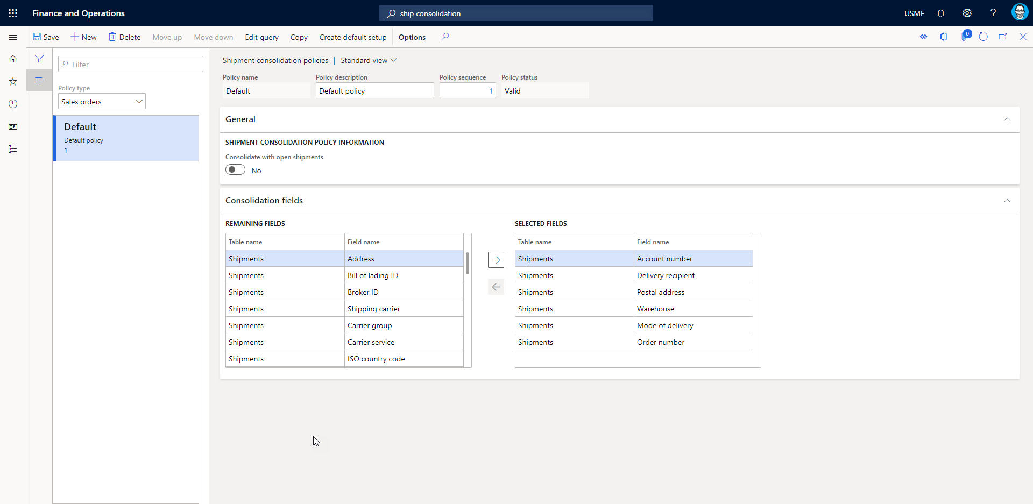
Consolidate shipment
Notes:
This feature allows for automated consolidation of shipment at the time of batch releasing sales or transfer orders. Shipment consolidation policies can be setup The policies have queries to define their applicability and a modifiable set of fields driving the decision for grouping load lines on shipment level automatically at release to warehouse. When releasing to warehouse manually the same logic is triggered when added to open shipments
Public Preview

Slide 54
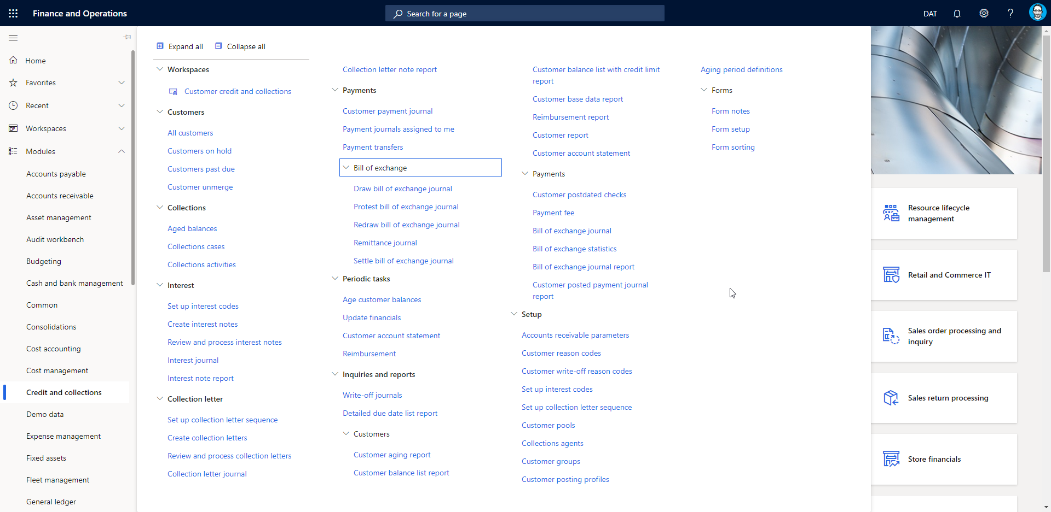
Credit management (10.0.8)
Notes:
Credit management allows you to create and manage credit limits, block customer orders based on rules and release those orders.

Slide 55
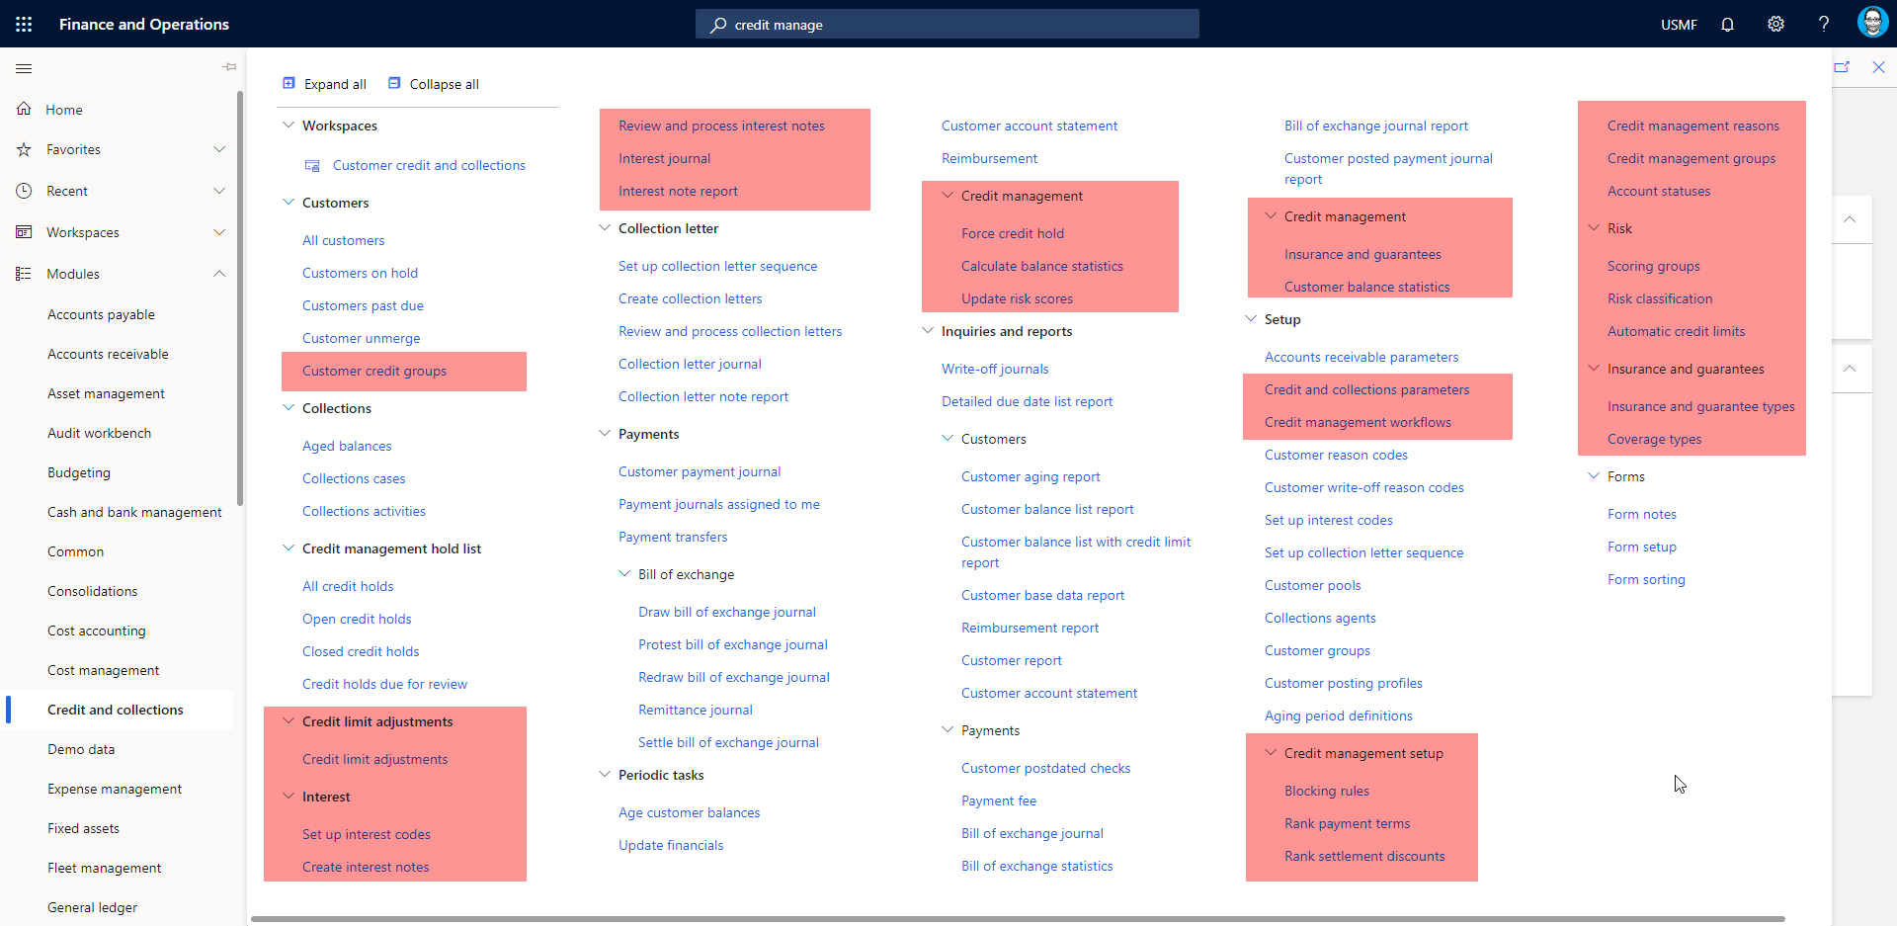
Credit Management (10.0.9)

Slide 56
Credit Management (10.0.9)
Management of risk scores
System-suggested credit limits
Configurable blocking rules
Dynamic release of credit holds
Credit limit management
Tracking historical credit limits

Slide 57
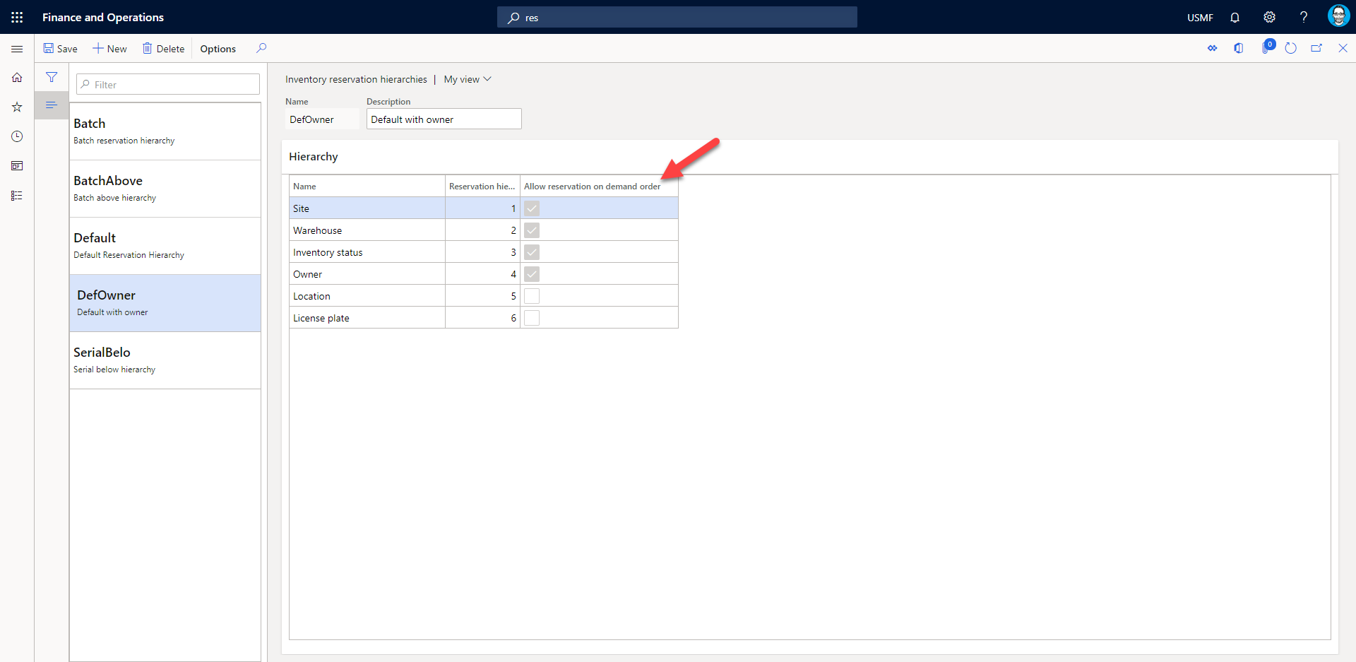
Flexible warehouse-level dimension reservation

Slide 58
Flexible warehouse-level dimension reservation
https://docs.microsoft.com/en-us/dynamics365/supply-chain/warehousing/flexible-warehouse-level-dimension-reservation
Batch number is the only level in the hierarchy that is open for the flexible reservation policy. In other words, you can't select the Allow reservation on demand order check box for the Location, License plate, or Serial number level
Reserve a specific batch number for a customer order
Allowing reservation of a specific batch on the sales order

Slide 59
Flexible warehouse-level dimension reservation
The flexible warehouse-level dimension reservation functionality doesn't support the following features:
Catch weight management
Physical negative inventory
Reservation against ordered supply
Transfer orders and raw material picking
Public Preview

Slide 60
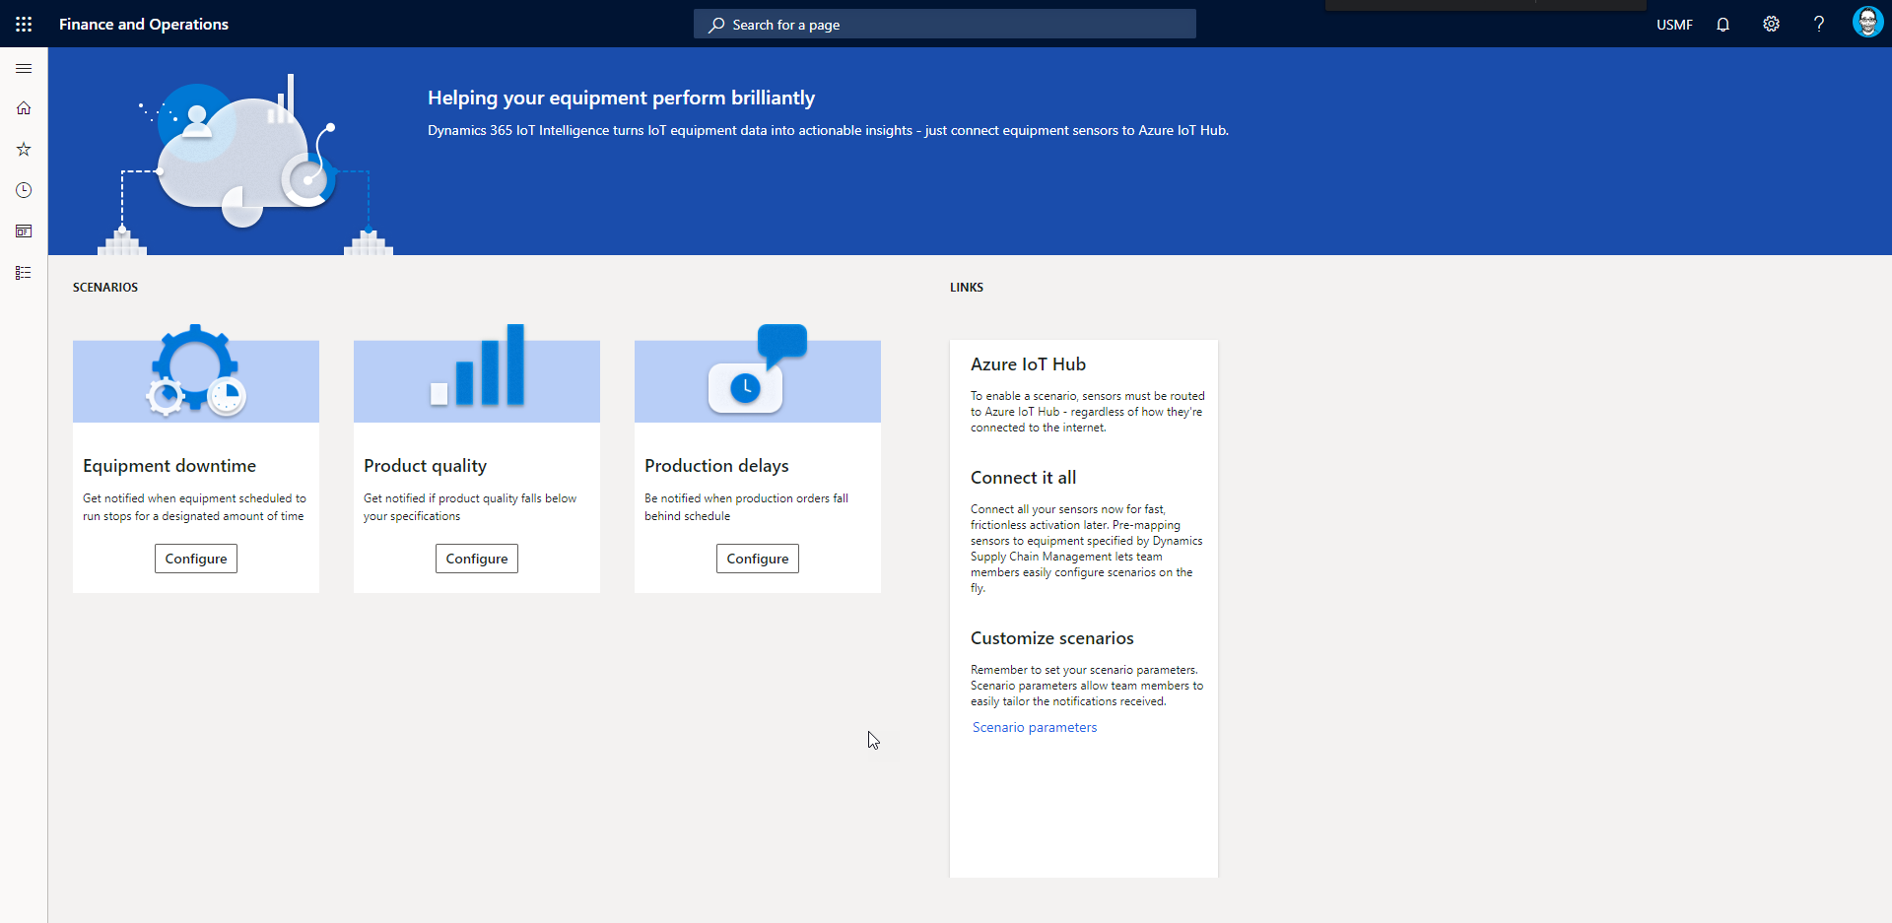
IoT Intelligence
Notes:
facilitates the tracking and optimization of the overall equipment effectiveness in real-time.

Slide 61
IoT Intelligence
Delayed orders
Equipment Down
Quality Anomolies
Automated Inventory Updates
No-code capabilities
Notes:
Provides notification services and actions for managing delayed production orders. Displays impacted operations. Provides users with the ability to define order-delay metrics for combinations of resources and products, and notifies users when exceptions to these thresholds occur.
Provides notification services and actions for managing equipment-down scenarios. Displays impacted operations. Provides users with the ability to define metrics for machine-down thresholds and notifies users when an exception to these thresholds occurs
Provides notification services and actions for managing quality anomalies. Provides users with the ability to define quality attributes for products and get notified when exceptions to these attributes occur
Provides automated inventory updates from the shop floor. Provides the ability to define batching/grouping rules for automatic inventory update journals and report as finished (RAF) creation based on part-out signals received from the IoT Hub.

Slide 62
Item consolidation location utilization
Stages work to consolidate locations
Removes work related to pending work already there
Finalized quantities for work and location
Creates movement work
Public Preview
Notes:
tool to warehouse managers to easily view and filter the volumetric utilization of location across the warehouse. If deemed necessary, the user can select locations and create inventory movement work straight from the form in order to consolidate items, better utilizing warehouse space.

Slide 63
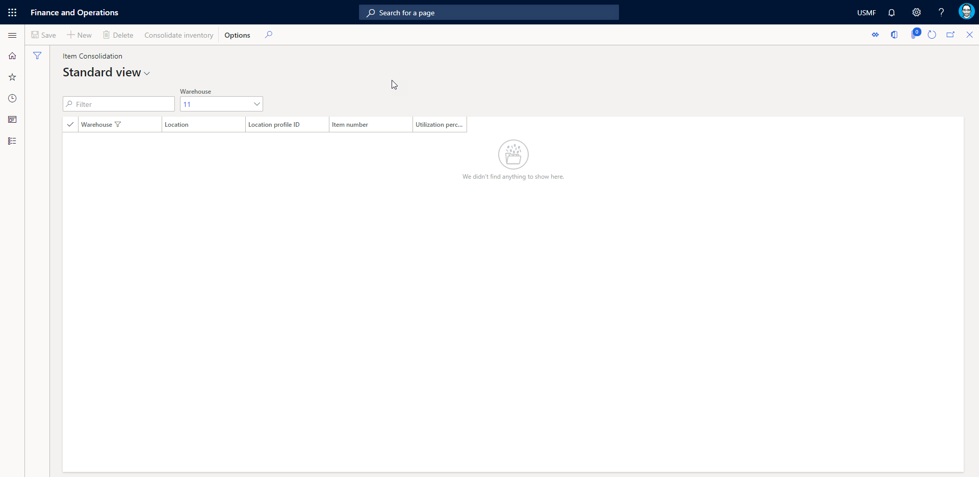
Item consolidation location utilization

Slide 64
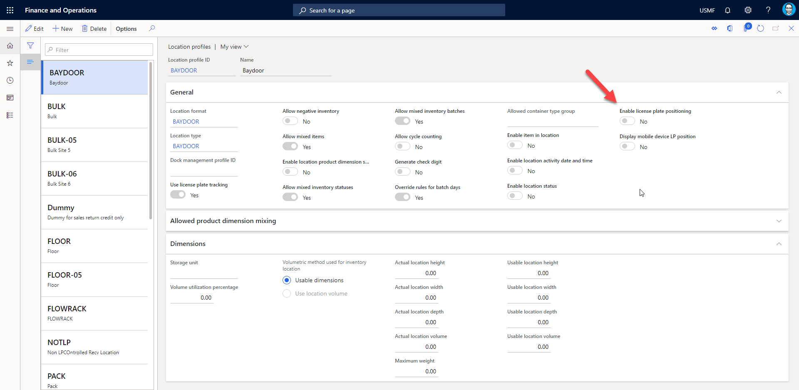
Location license plate positioning
Notes:
LP Location positioning allows the user to see where the LP is located a multi pallet location, such as double deep pallet racking. This functionality adds an sequence number to the license plate for each license plate that is put to a location. The sequence number orders the license plates within a storage location. This feature intelligently solves scenarios where customers are using gravity racking system and need to know which license plate is front facing for picking purposes.
Public Preview

Slide 65
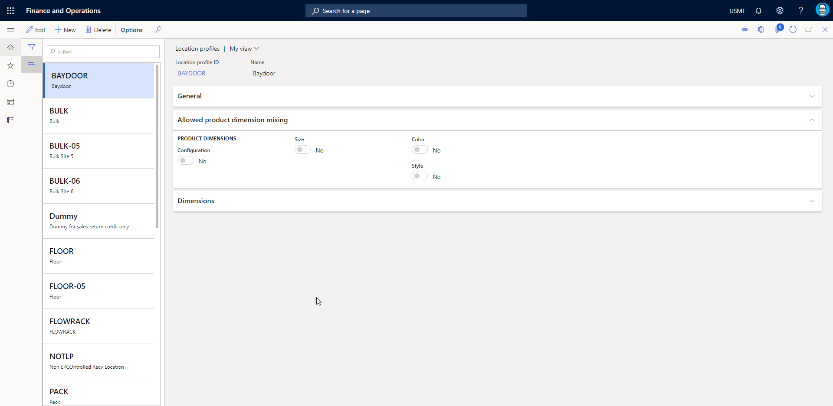
Location product dimension mixing
Notes:
Allows config, size, color, style mixing for a location profile id
let allows you to decide whether configurations, colors, style, and sizes can be mixed on a certain location (profile) or if only one or a combination of some of those dimensions can be put to the same location.
Public Preview

Slide 66
Manual shipment consolidation
Create consolidation policies
Review changes policies with several other filters
Review results
Manually consolidate, if able
Public Preview
Notes:
The manual consolidation of shipments is a time-driven requirement – some shipments get consolidated at release to warehouse, however, some should be consolidated when they are already at the dock.

Slide 67
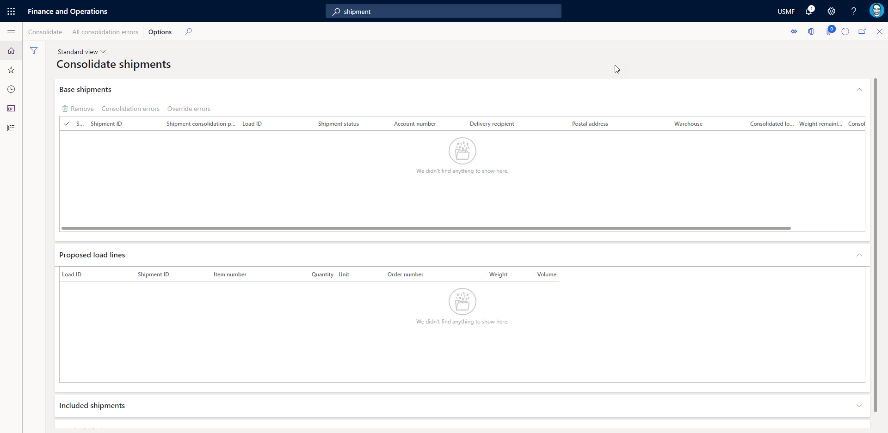
Manual shipment consolidation

Slide 68
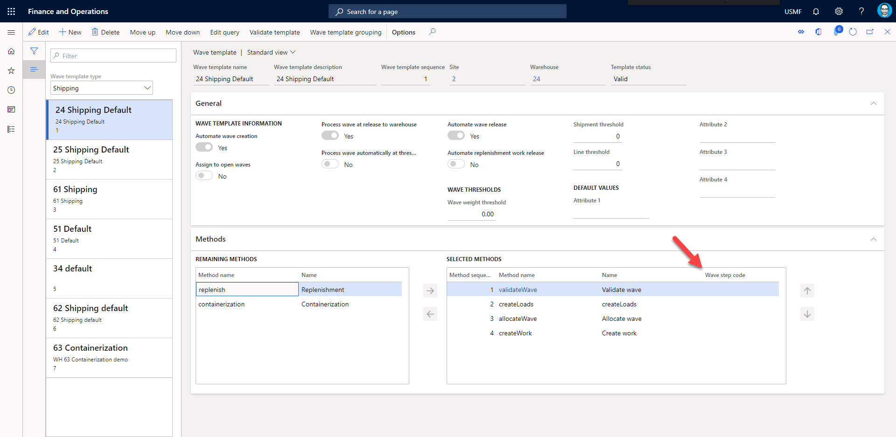
Organization wide wave step code
Notes:
Organization wide wave step code enables the wave step code feature for all legal entities. The wave step code feature ensures that wave step codes no longer are based on free text but on codes stored in a dedicated table for wave step codes. Going forward, a user has to select between predefined wave step codes when using wave step codes to link specific wave method instances with their corresponding templates.

Slide 69
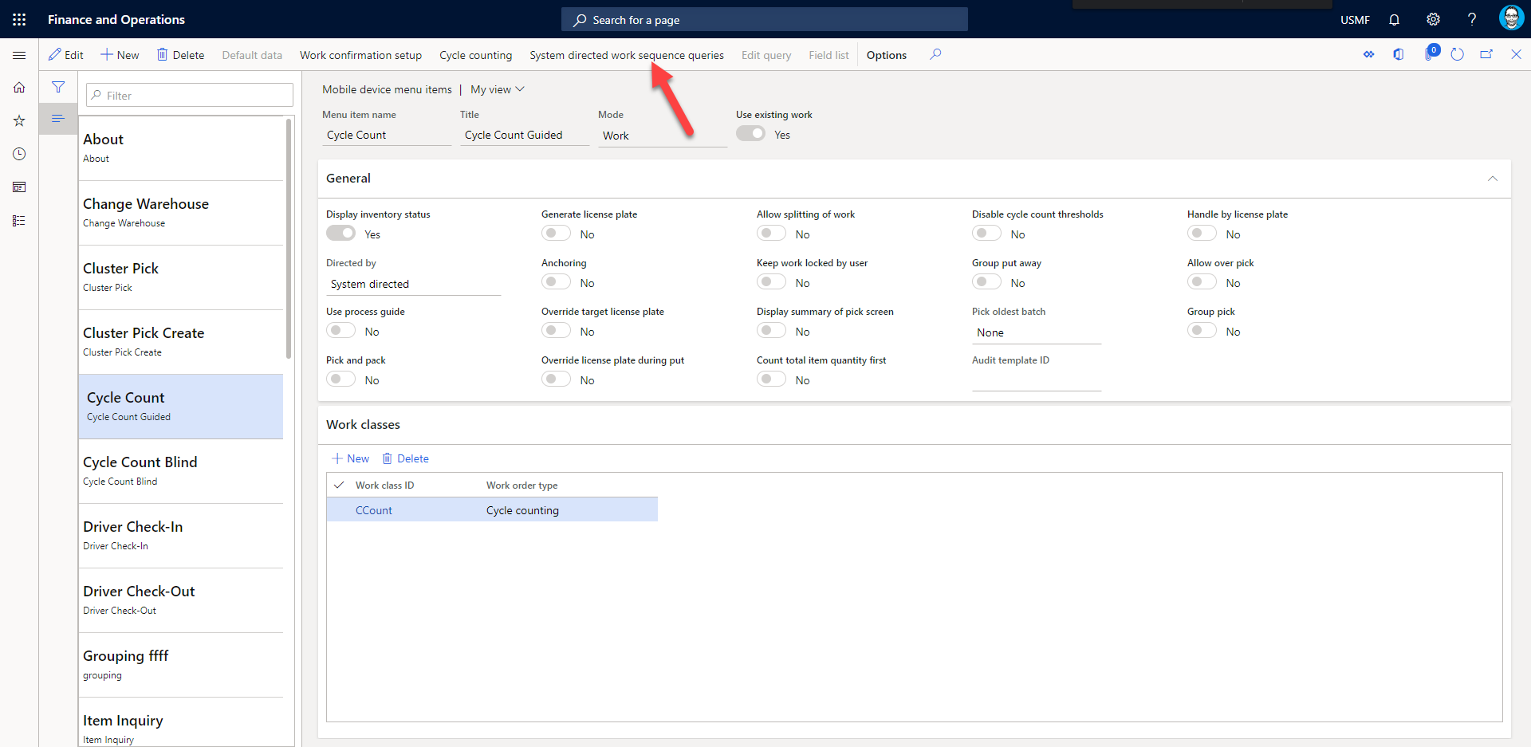
Organization-wide system directed work sequencing
Notes:
extends the current system directed picking with new System directed query order where the user can set up a sequence and a query or multiple queries which will evaluate all created work orders. It will therefore capture and present only the work orders that meet the specified criteria of the mobile device menu item setup. Organization-wide system directed work sequencing enables the system directed work sequencing feature for all legal entities within the organization.
Public Preview

Slide 70
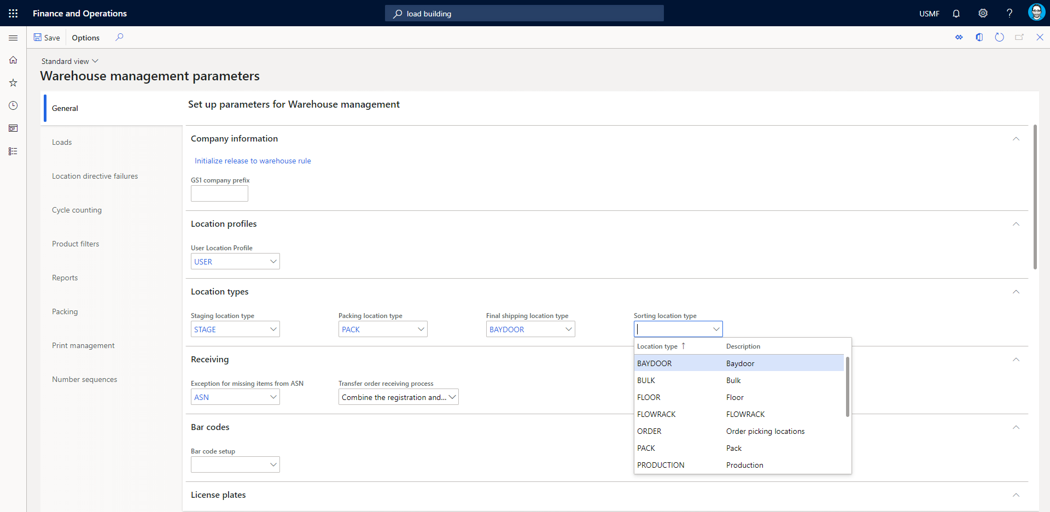
Outbound sorting
Notes:
Pallet building offers the ability to sort packed containers to a correct pallet after the packing station and to build a packing hierarchy. Such pallets can later be moved to the correct staging location with a single work order capturing all packed containers. The warehouse worker has the freedom to choose which pallet the packed container should be put to, the maximum number of boxes a pallet can have, and how many pallets are needed in any given scenario.
Public Preview

Slide 71
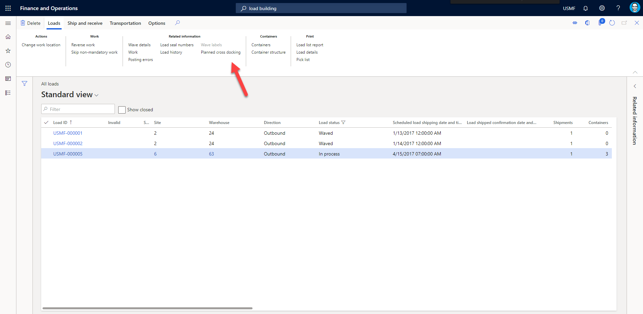
Planned cross docking
Notes:
introduces advanced, planned cross-docking where all of the inbound inventory required to satisfy an existing order can be moved directly to the correct outbound dock or staging area without being put away. All remaining inventory from the inbound source is directed to the correct storage location through the regular put-away process. Cross-docking allows workers to skip inbound put-away and outbound picking of inventory that is already marked for inclusion in an outbound order.
Public Preview

Slide 72
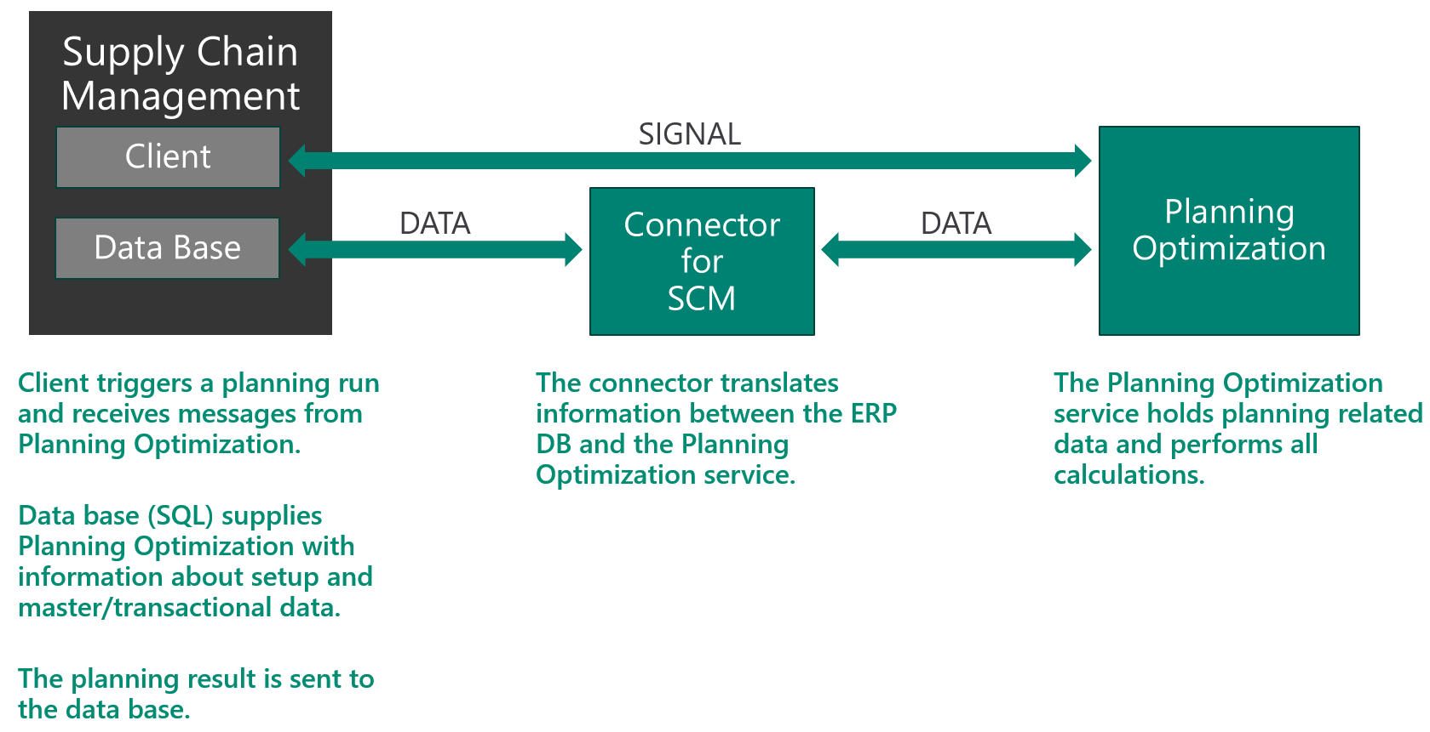
Planned production orders for Planning Optimization
Notes:
https://docs.microsoft.com/en-us/dynamics365/supply-chain/master-planning/planning-optimization/planning-optimization-overview
Public Preview

Slide 73
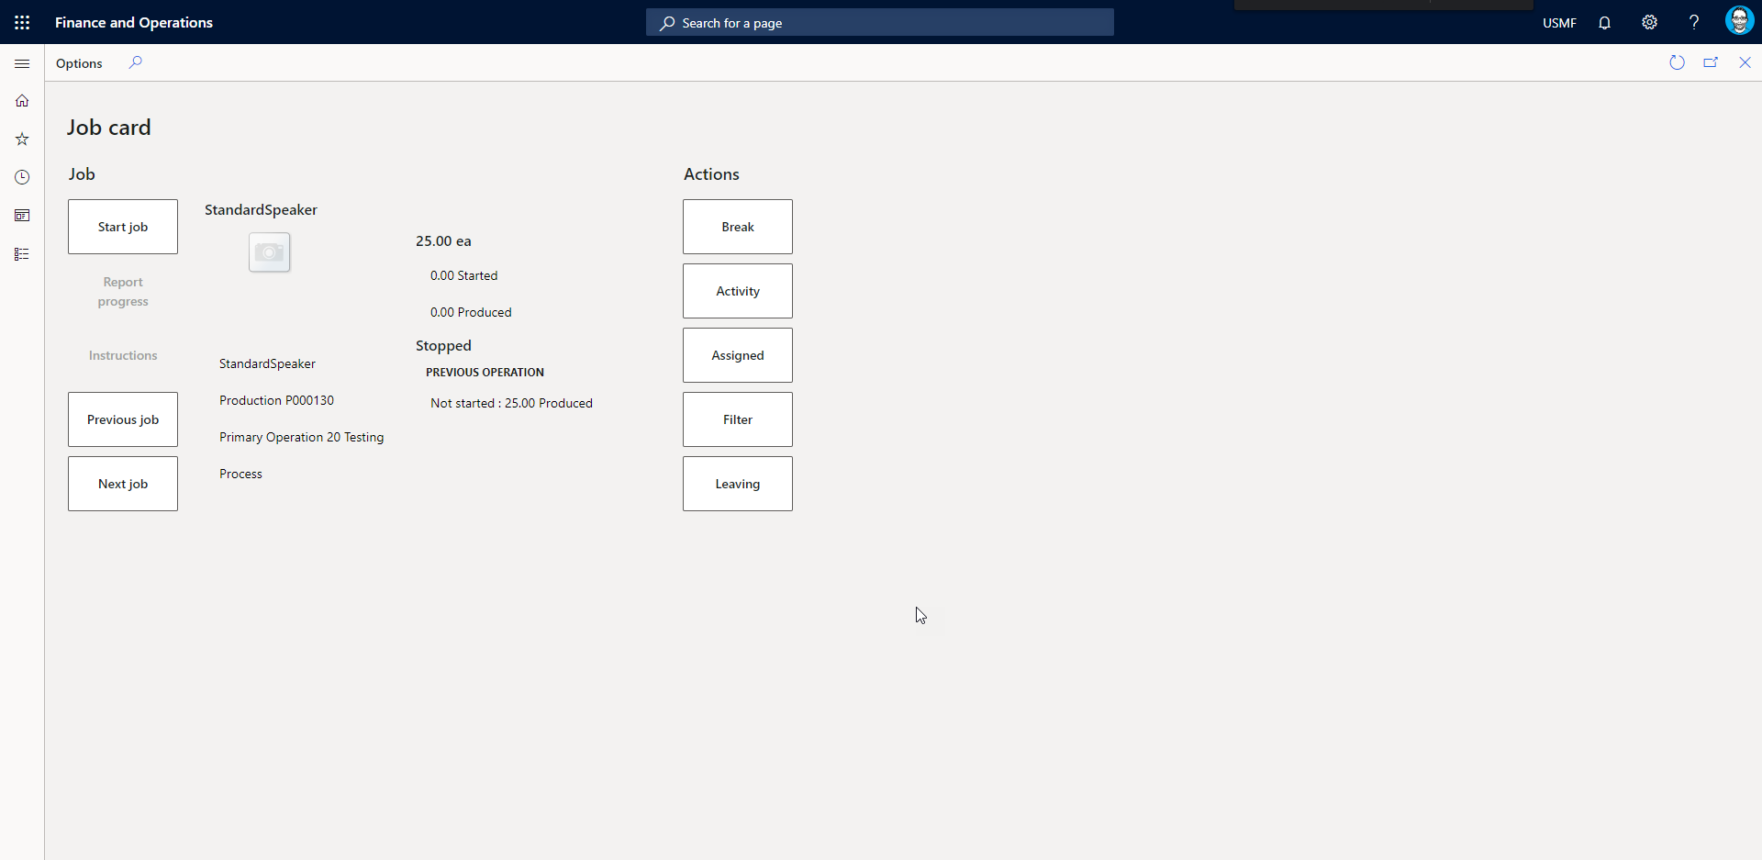
Improved user experience for the Report progress dialog in the Job Card Device.

Slide 74
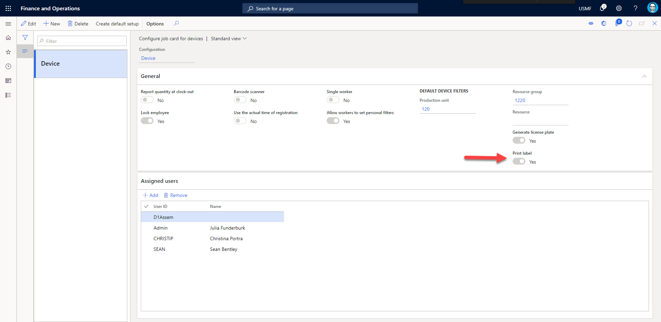
Print label from Job Card Device
Notes:
This feature enables the printing of a label when reporting as finished from the Job Card Device. The label is a part of document routing and enabled in the configure job card for devices page.

Slide 75
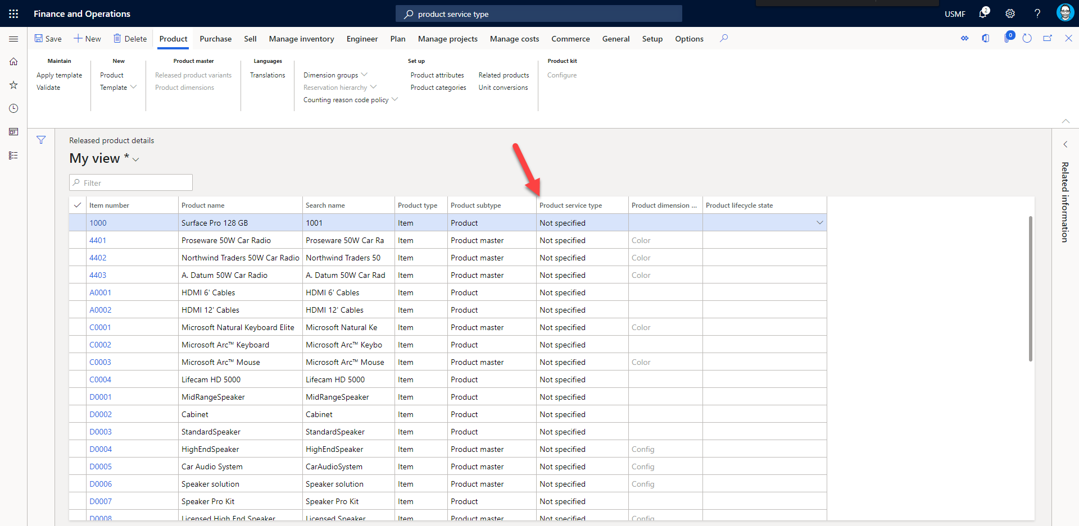
Product service type
Notes:
Add sub types for products of type service. Opens the door for services types like warranties but little functionality currently.
Released

Slide 76
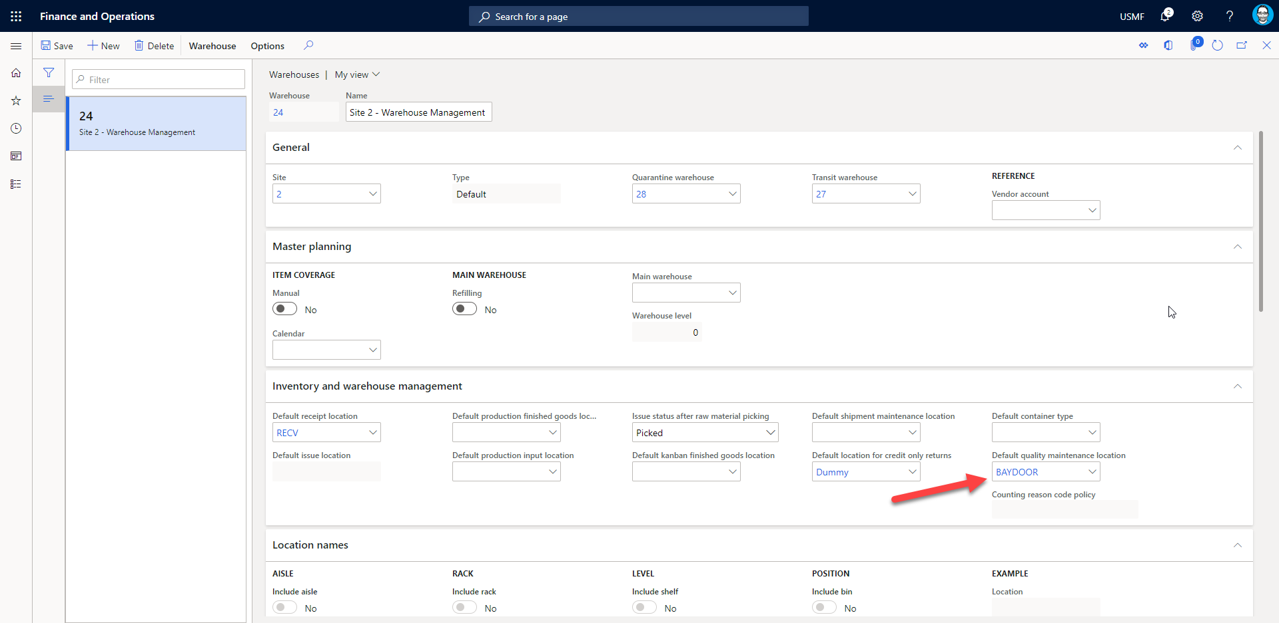
Quality check (WHS)
Notes:
This function offers an alternative to existing quality check process with more flexibility and faster processing. At the time of receiving, the worker is required to perform a desired quality check and must decide whether to accept or reject each license plate scanned after they have been registered. Accepted license plates will be guided to the storage location as normal, while rejected license plates will be diverted to a quality check location for further inspection.
Public Preview

Slide 77
Replenishment over location capacity
Notes:
The features allow more replenishment work to be created than will fit in a location and will block replenishment work from being completed once the location is full. As inventory in the pick location drops below a configurable threshold, more replenishment work will be made available.
Largely for high volume or space constrained warehouses
Public Preview

Slide 78
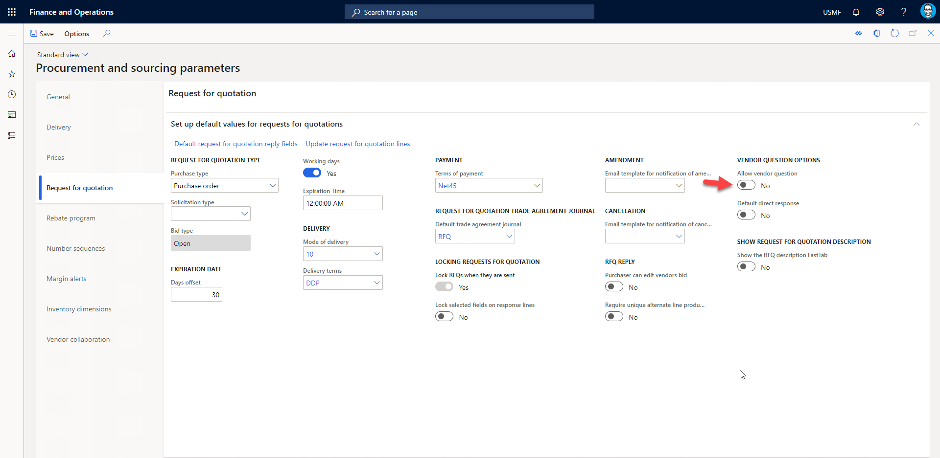
RFQ questions and answers
Notes:
When your agency has sent a request for quotation (RFQ), vendors sometimes have questions that pertain to the request. Vendors that have questions related to an RFP can submit their questions and read the answers on Vendor collaboration page, when you make that page available to them. When vendor questions are accepted, Questions and answers is available on the Request for quotation bid page on Vendor collaboration, and for your agency through the Request for quotation page, Questions and answers.
Users can publish answers to vendor questions more than once. Vendors can't no longer post questions after a vendor is selected and the RFQ is awarded, or after the cutoff date for questions is reached.

Slide 79
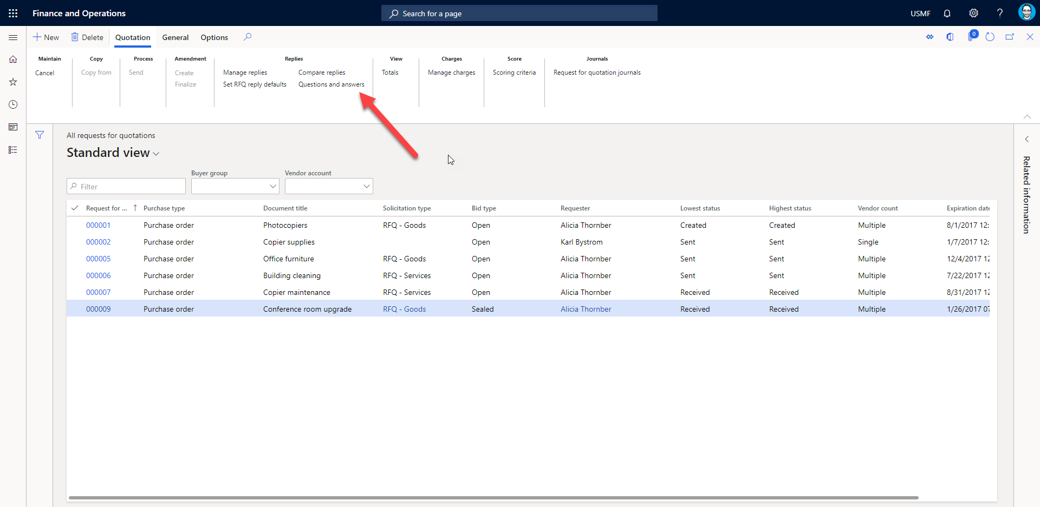
RFQ questions and answers

Slide 80
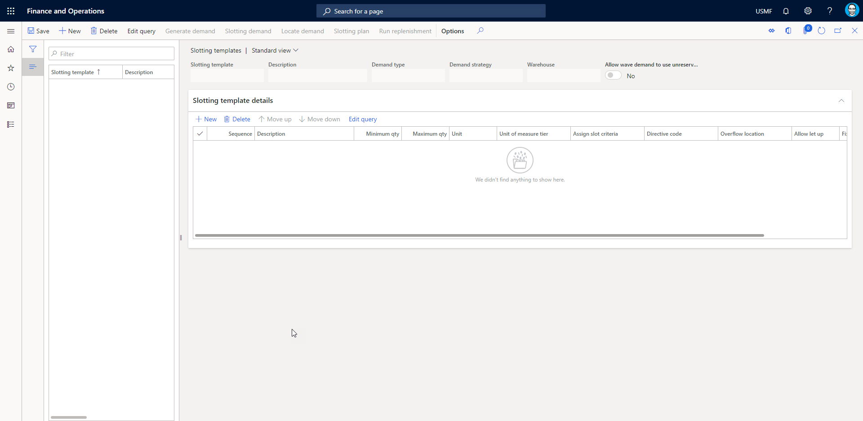
Warehouse slotting feature
Notes:
Slotting allows users to gather consolidate demand by item and unit of measure from orders, in status either ordered, reserved, or release. Once demand has been generated, it can be located to locations that will be used for picking based on quantity, unit, physical dimensions, fixed locations, etc. Once the slot plan has been established, replenishment work can be created to bring the appropriate amount of inventory to each location.
Public Preview

Slide 81
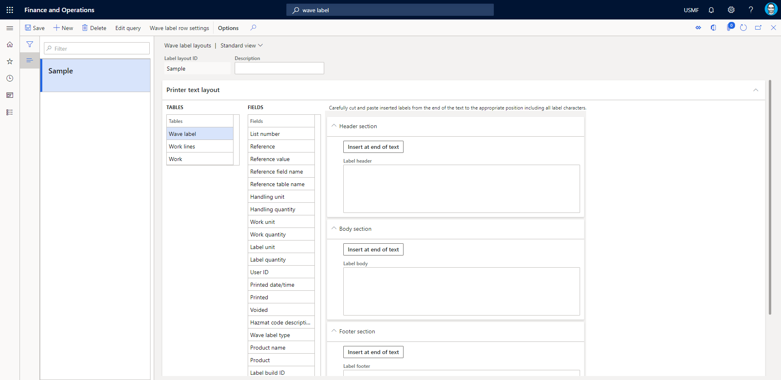
Wave label printing
Notes:
Allow for labels to be printed according to number of cartons on a single work line. Without using the containerization feature, this would mean that for a quantity of 100 cartons, the feature will print out 100 labels.
Public Preview
Include an enumeration of the labels (1/124, 2/124 … 124/124).
Allow for a bill of lading (BOL) to be created and printed on the label.
Allow a unique Serial Shipping Container Code (SSCC) to be created per carton and included on the label.
Allow for the creation of a GS1-compliant number sequence for BOL and SSCC numbers.
Allow for a HAZMAT code to be included (if relevant) on the label.
Support reprint of labels (from hand-held devices, as from a rich client).
Support for voiding of labels (for example, for short pick scenarios) and reprint.
Support for clean-up of wave label history.

Slide 82
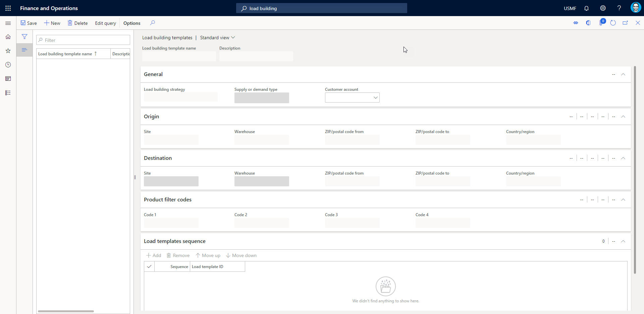
Wave Load building feature
Notes:
The load building features allows users to create loads automatically based on user defined criteria. A load build template is created, which links to a specific wave template method, and controls what load (existing or new) load lines being waved will be added to. Users can also choose whether to evaluate the volumetric restriction of the load template, or if volumetric/weight maximums should not be considered and only other criteria.
Public Preview

Slide 83
THANK YOU!
Any questions now?
If not, you can always contact me later:
Nathan Clouse
Nathan.Clouse@DynamicConsulting.com
@NathanClouseAX

Slide 84


